Slide 1


Welcome to

Slide 2
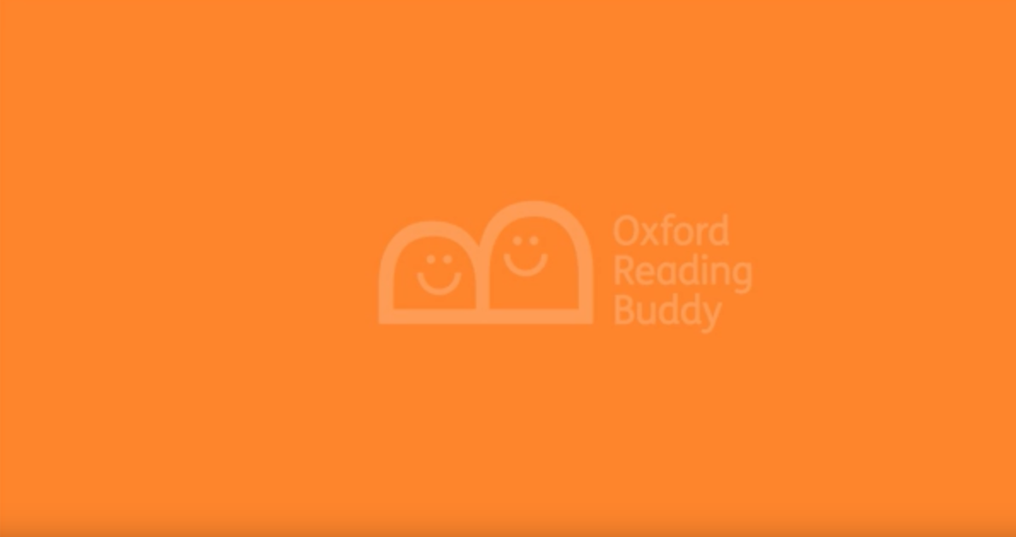
Introducing Oxford Reading Buddy
We have recently bought a fantastic new resource designed to support and improve your child’s reading and comprehensive skills, both in school and, at home.
Here’s a short video explaining how the resource works.

Slide 3
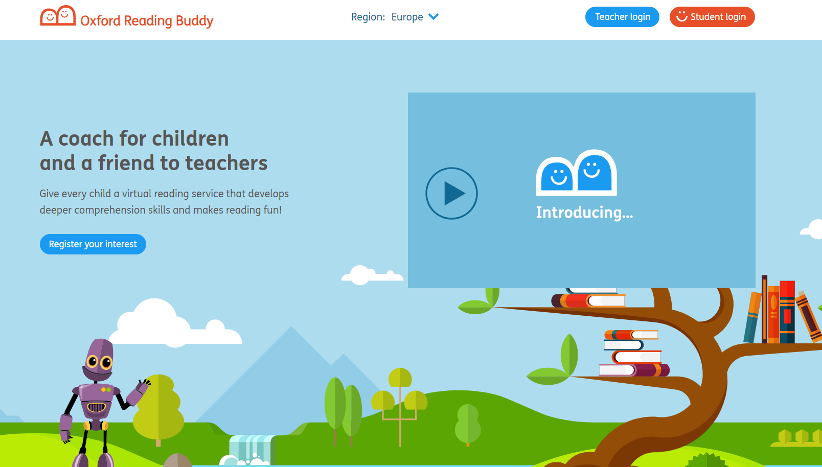
Logging on to
Oxford Reading Buddy
www.oxfordreadingbuddy.com
Student Login

Slide 4
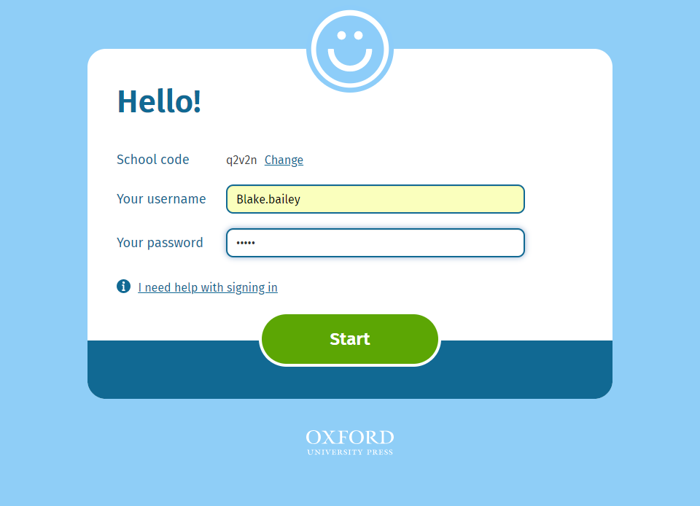
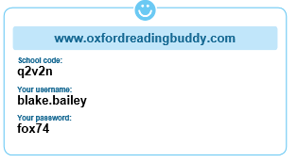
Logging on to
Oxford Reading Buddy

Slide 5
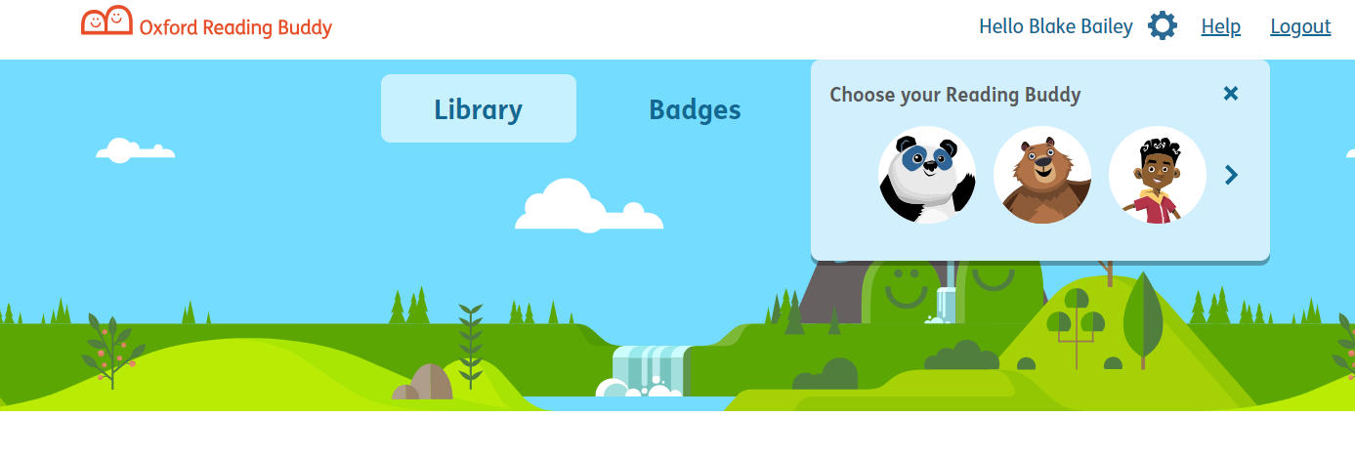
Choosing a Reading Buddy
Settings
The chosen Reading Buddy will guide and support you through your child through their reading journey.

Slide 6
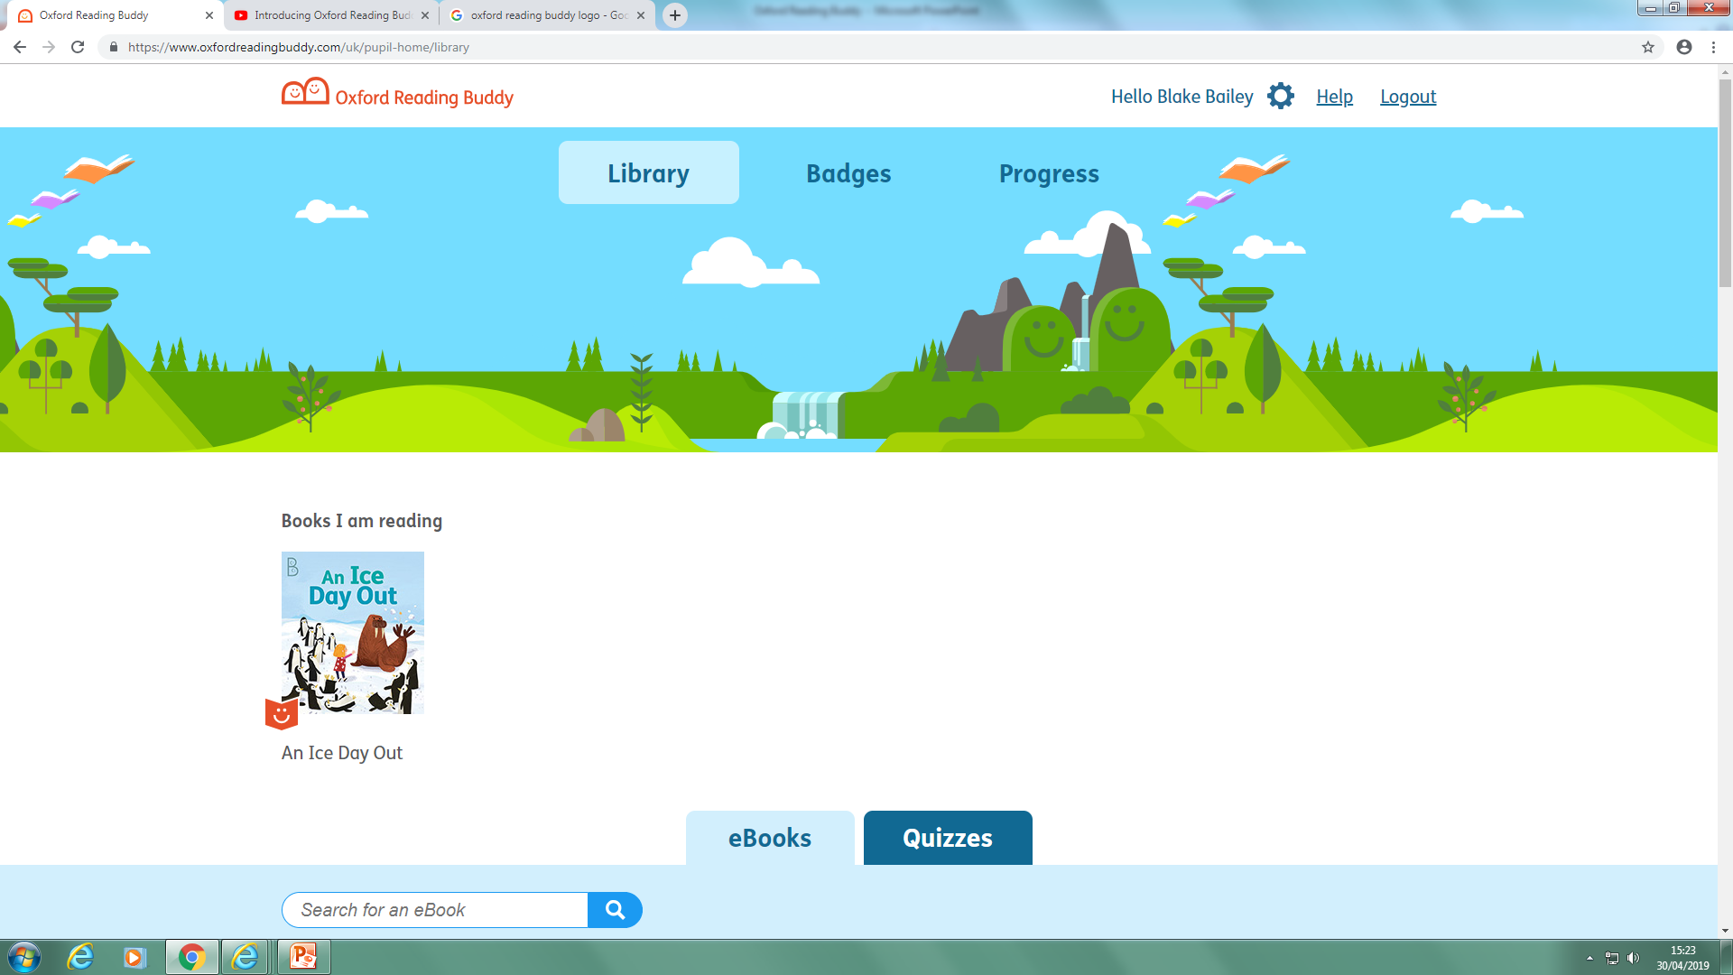
Reading Buddy Dashboard
Library – A expansive range of reading books to meet your child’s reading level.
Badges – Rewards you can collect as you complete reading books and quizzes.
Progress – Shows how many books have been read. You can also enter other books you have read.

Slide 7
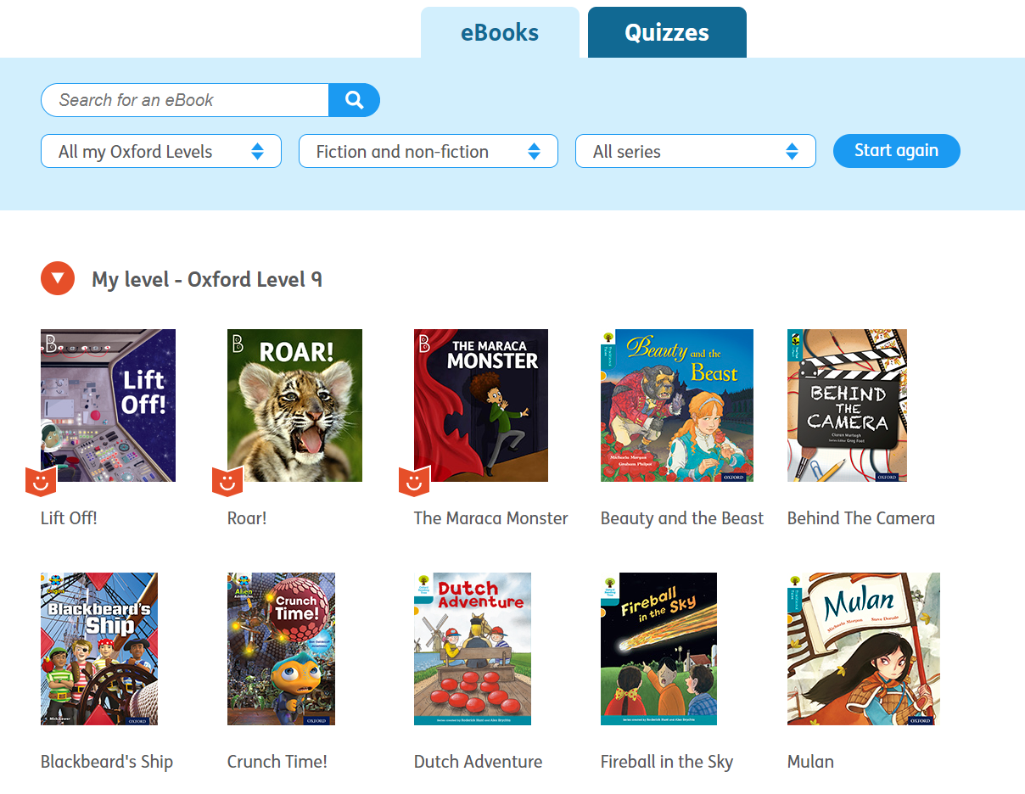
Reading Buddy Library
Reading Levels have been allocated by the child’s teacher and match the level reading book they take home.
There are over 20 ebooks available per reading level. These cover a range of fiction, non-fiction and poetry texts.
The ebooks and paper reading books are not duplicated giving an expansive range of texts.

Slide 8
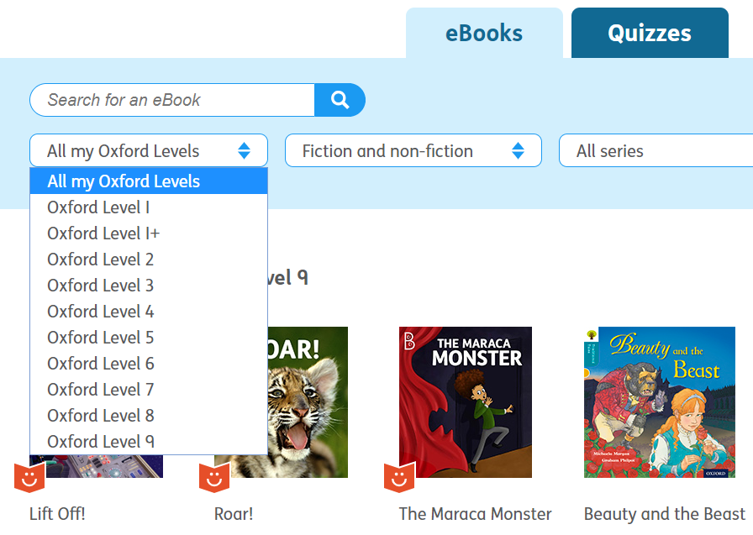
Reading Buddy Library
You will only be able to access ebooks at the reading level your child is on, as well as previous completed levels.
Once your child’s teacher is ready to move them onto the next level, they will allocate the next level.

Slide 9
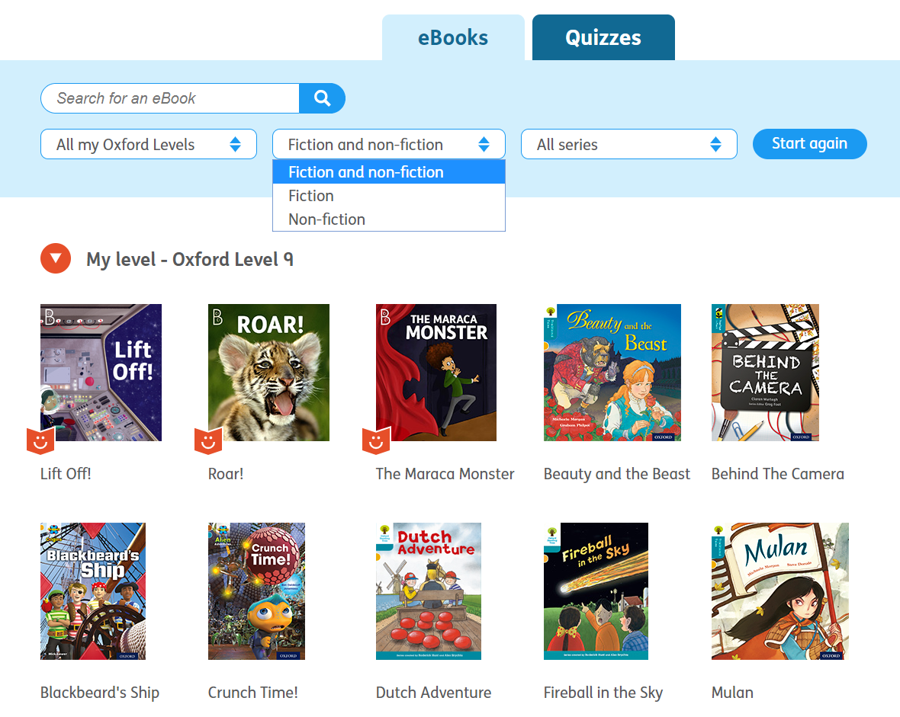
Reading Buddy Library
You can choose to read Fiction or
Non-Fiction texts.

Slide 10
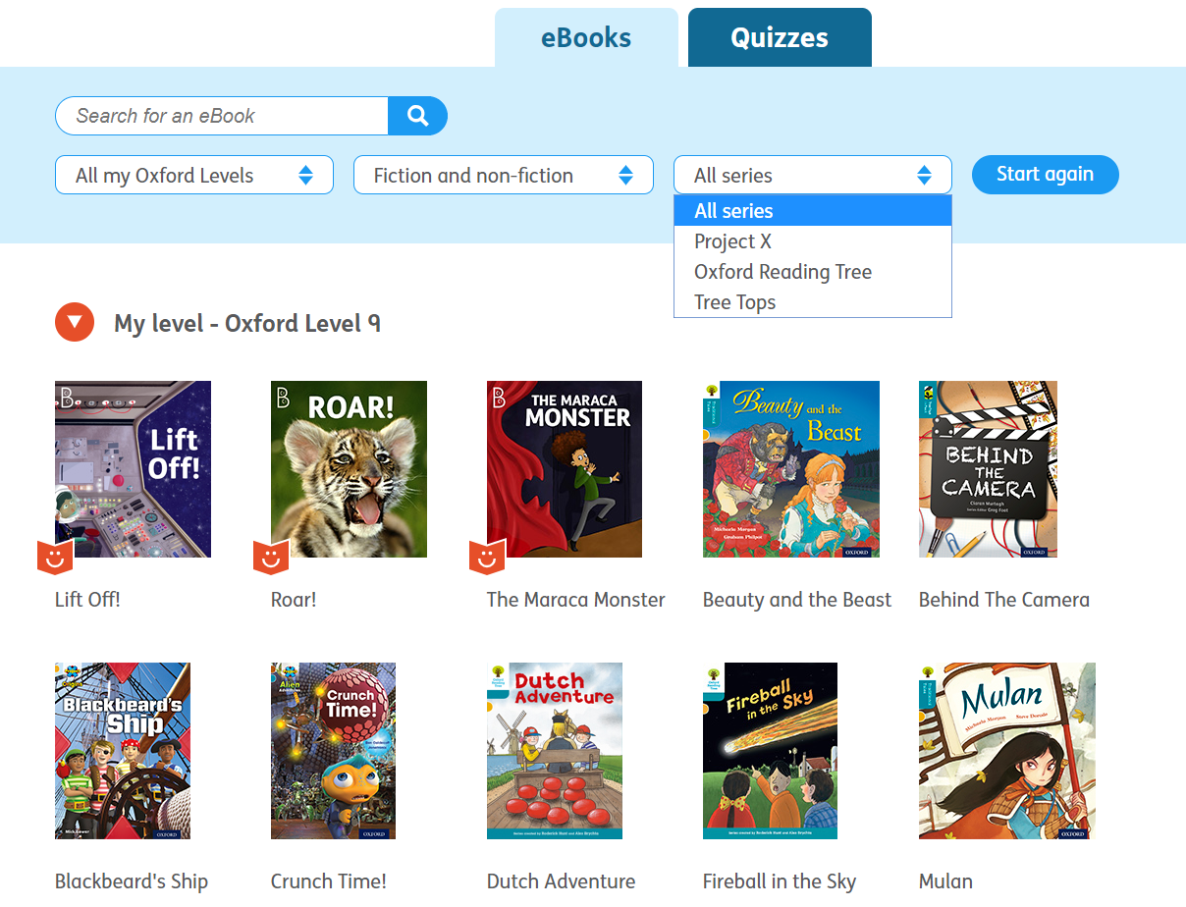
Reading Buddy Library
You can choose books from different series.
You do not have to read the ebooks in any particular order, your child can choose the ebook that interests them.

Slide 11
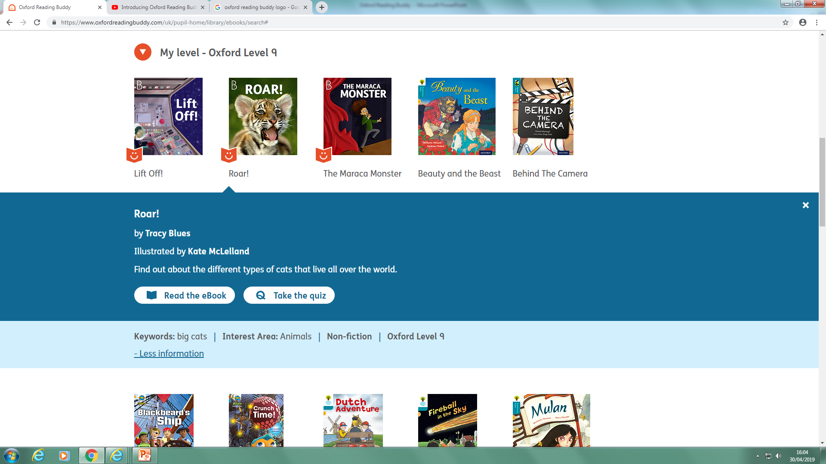
Coaching eBooks
If you see this icon it means this is a coaching eBook, it has been specially written to develop comprehension strategies and skills. Each book models comprehension strategies and encourages the student to engage more reflectively to develop a deeper response to texts.

Slide 12
eBooks
When you select a book it gives you the title, author and illustrator. It also gives you an explanation about what the book is about, this would normally be found in the blurb on the back cover.

Slide 13
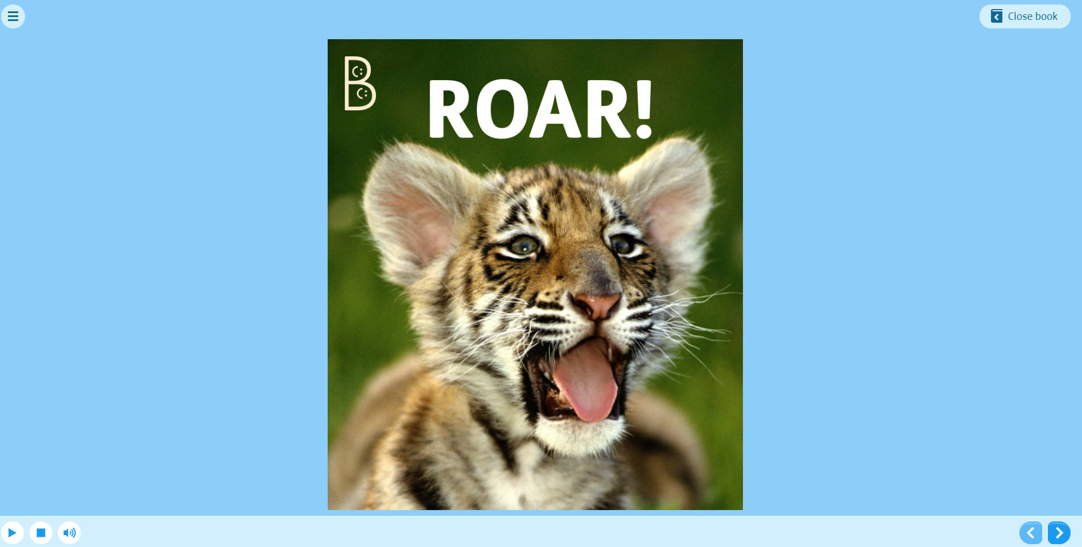
eBooks
Close the book
Play, stop and volume controls
Turn the pages

Slide 14
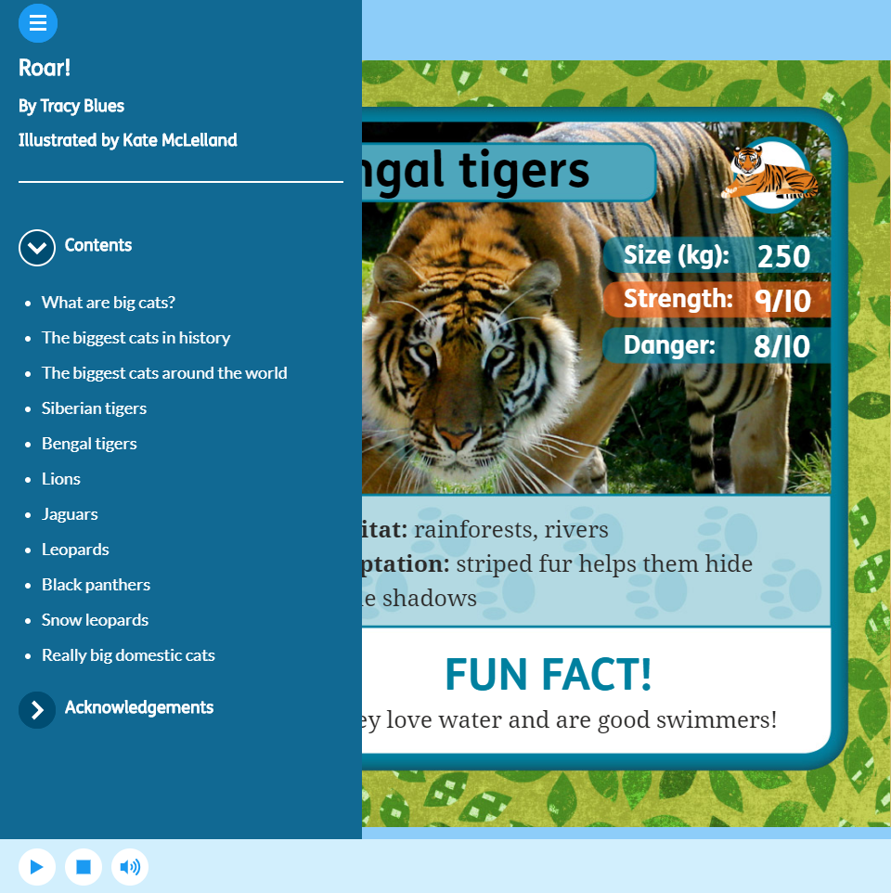
eBooks
This will give you a contents page of the book. You can choose section that interest you or the pick up from the chapter that you finished at last time.

Slide 15
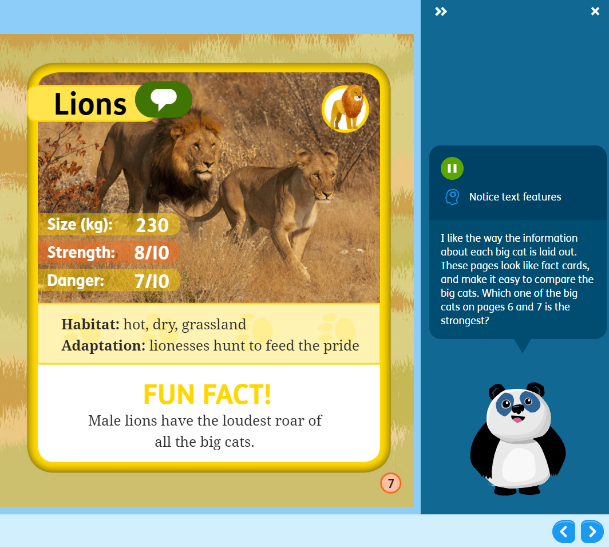
eBooks
Throughout the text you will notice Green speech bubbles. These will give you information about text features or ask you questions that you can answer as you read the book?

Slide 16
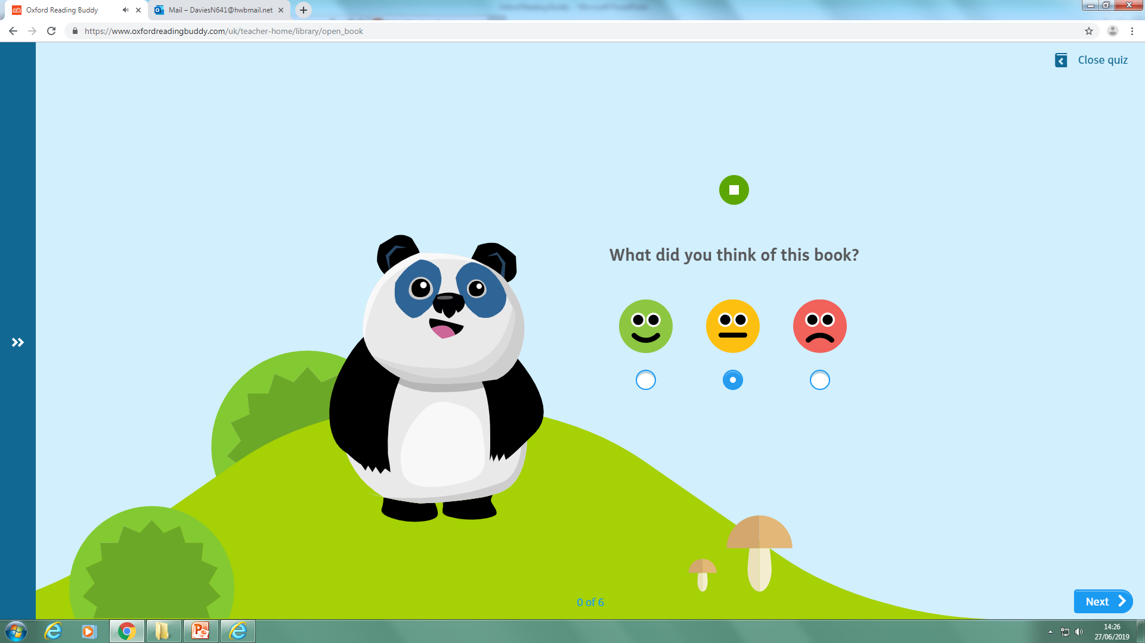
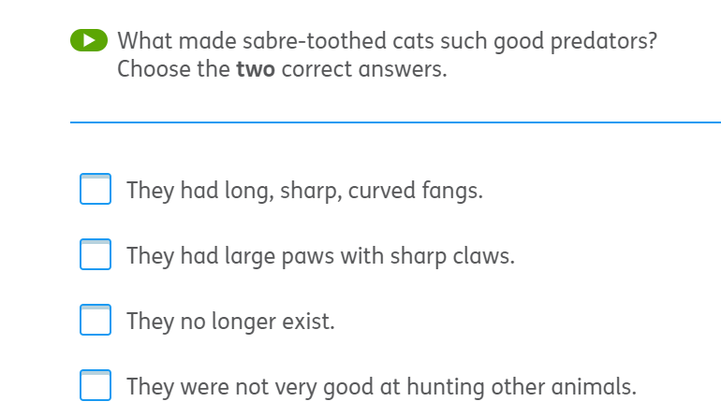
Quizzes
Once you have read the book, you can complete the quiz. You will be presented with a range of question styles.
Book Review
Multiple choice

Slide 17
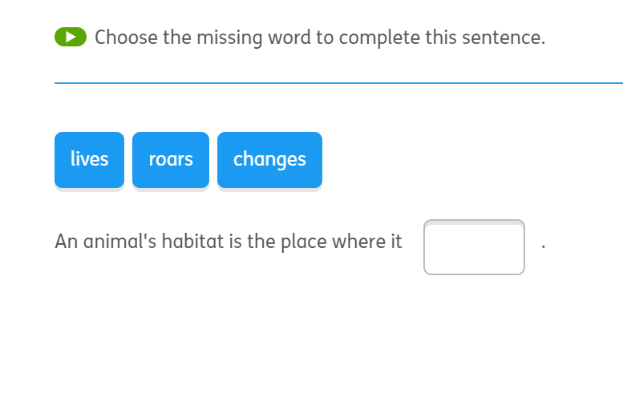
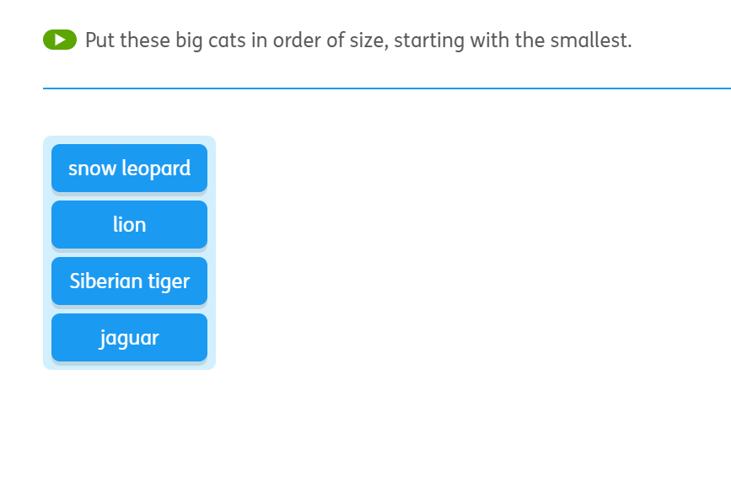
Quizzes
Complete the sentence
Sequencing

Slide 18
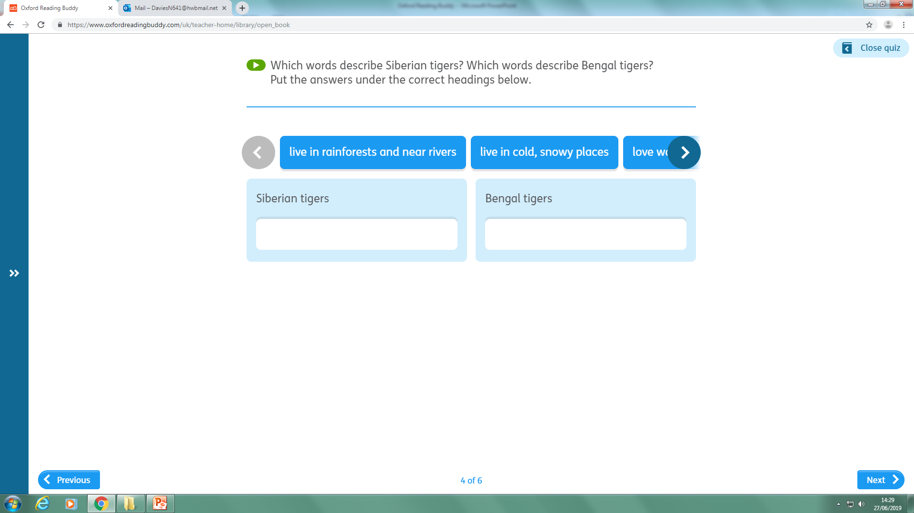
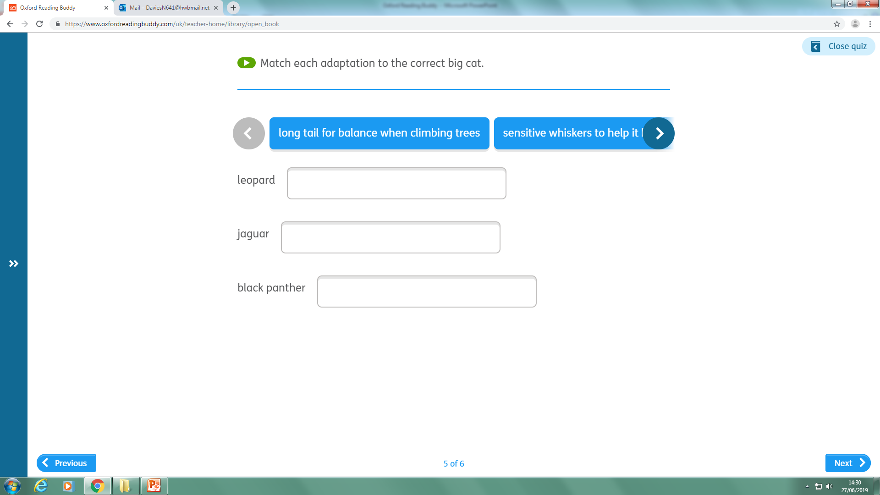
Quizzes
Sorting into groups
Matching descriptions

Slide 19
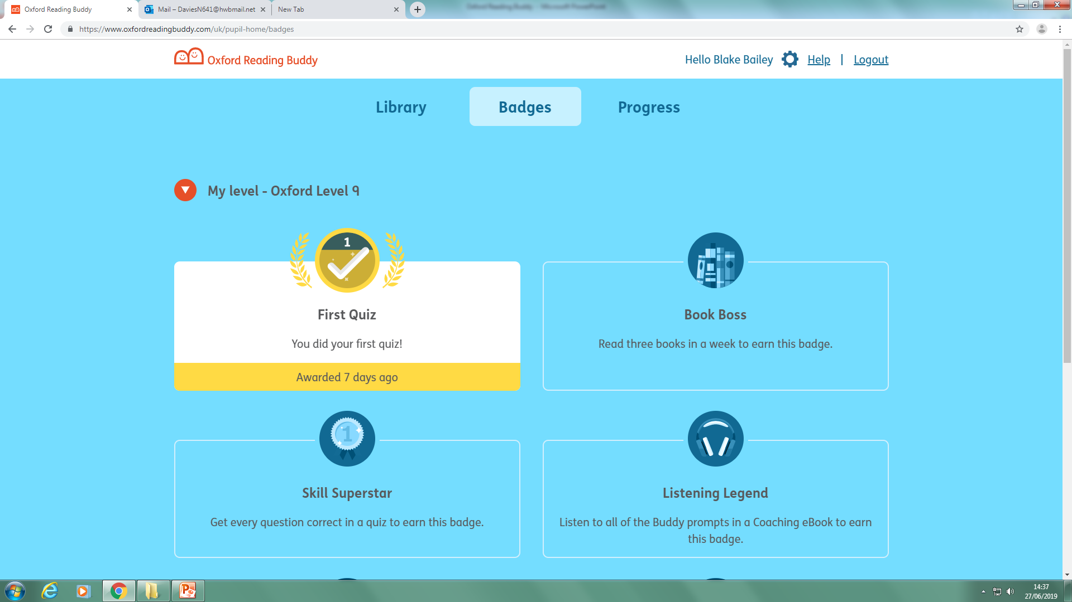
Badges
The children can earn badges once they have:
Completed their 1st quiz
Read 3 books
Full marks in a quiz
Listened to all coaching ebook prompts
Completed their 5th, 10th, 15th and 20th quiz.

Slide 20
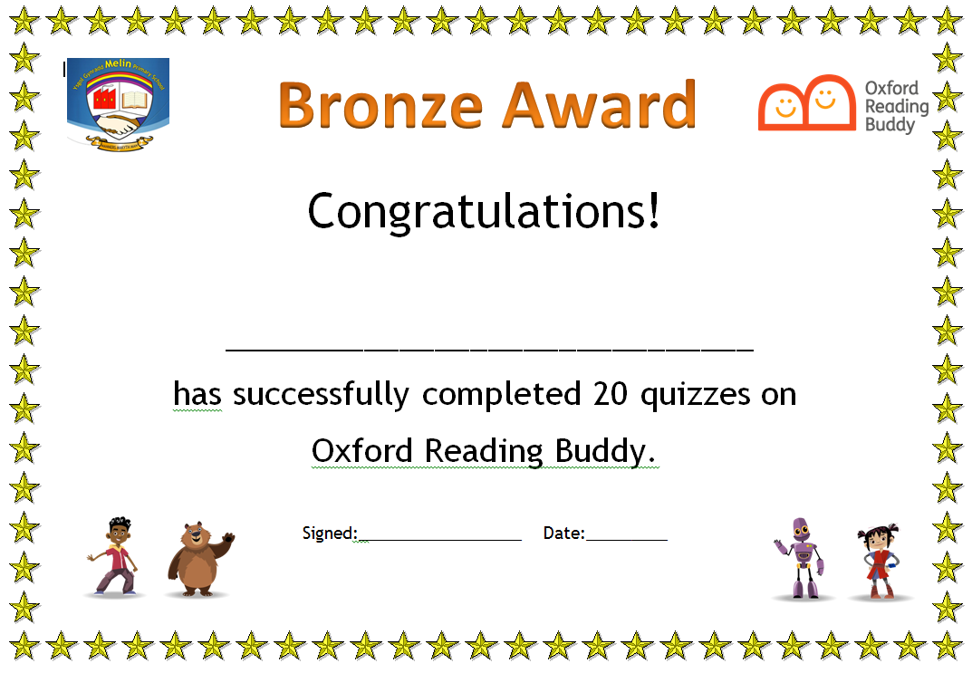
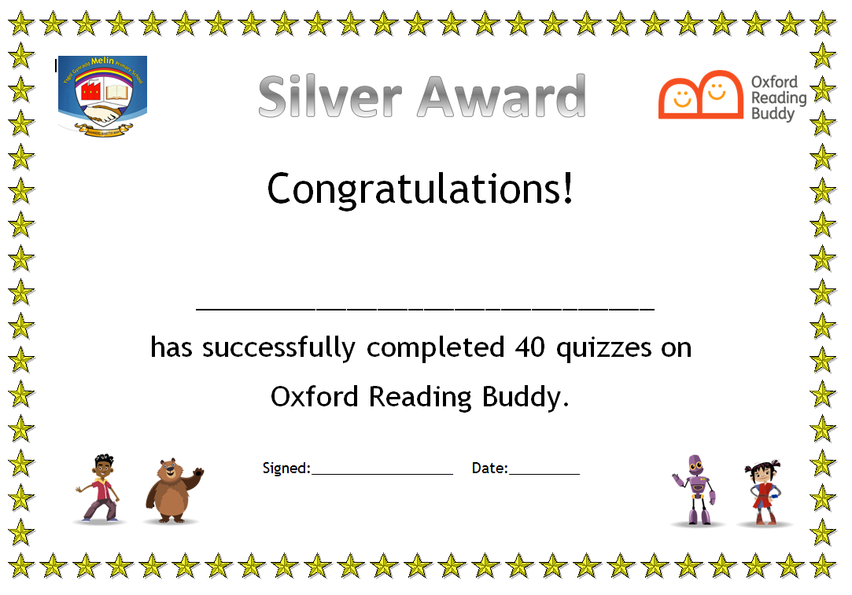
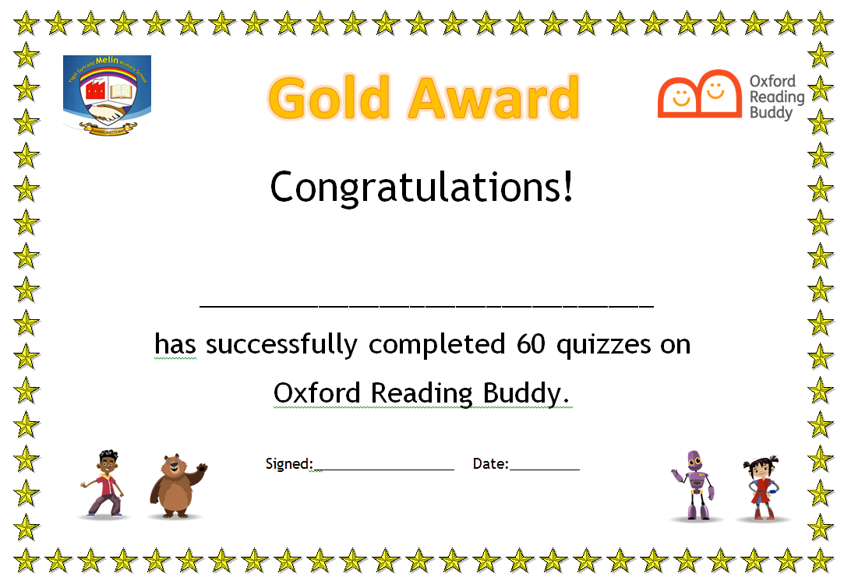
Certificates

Slide 21
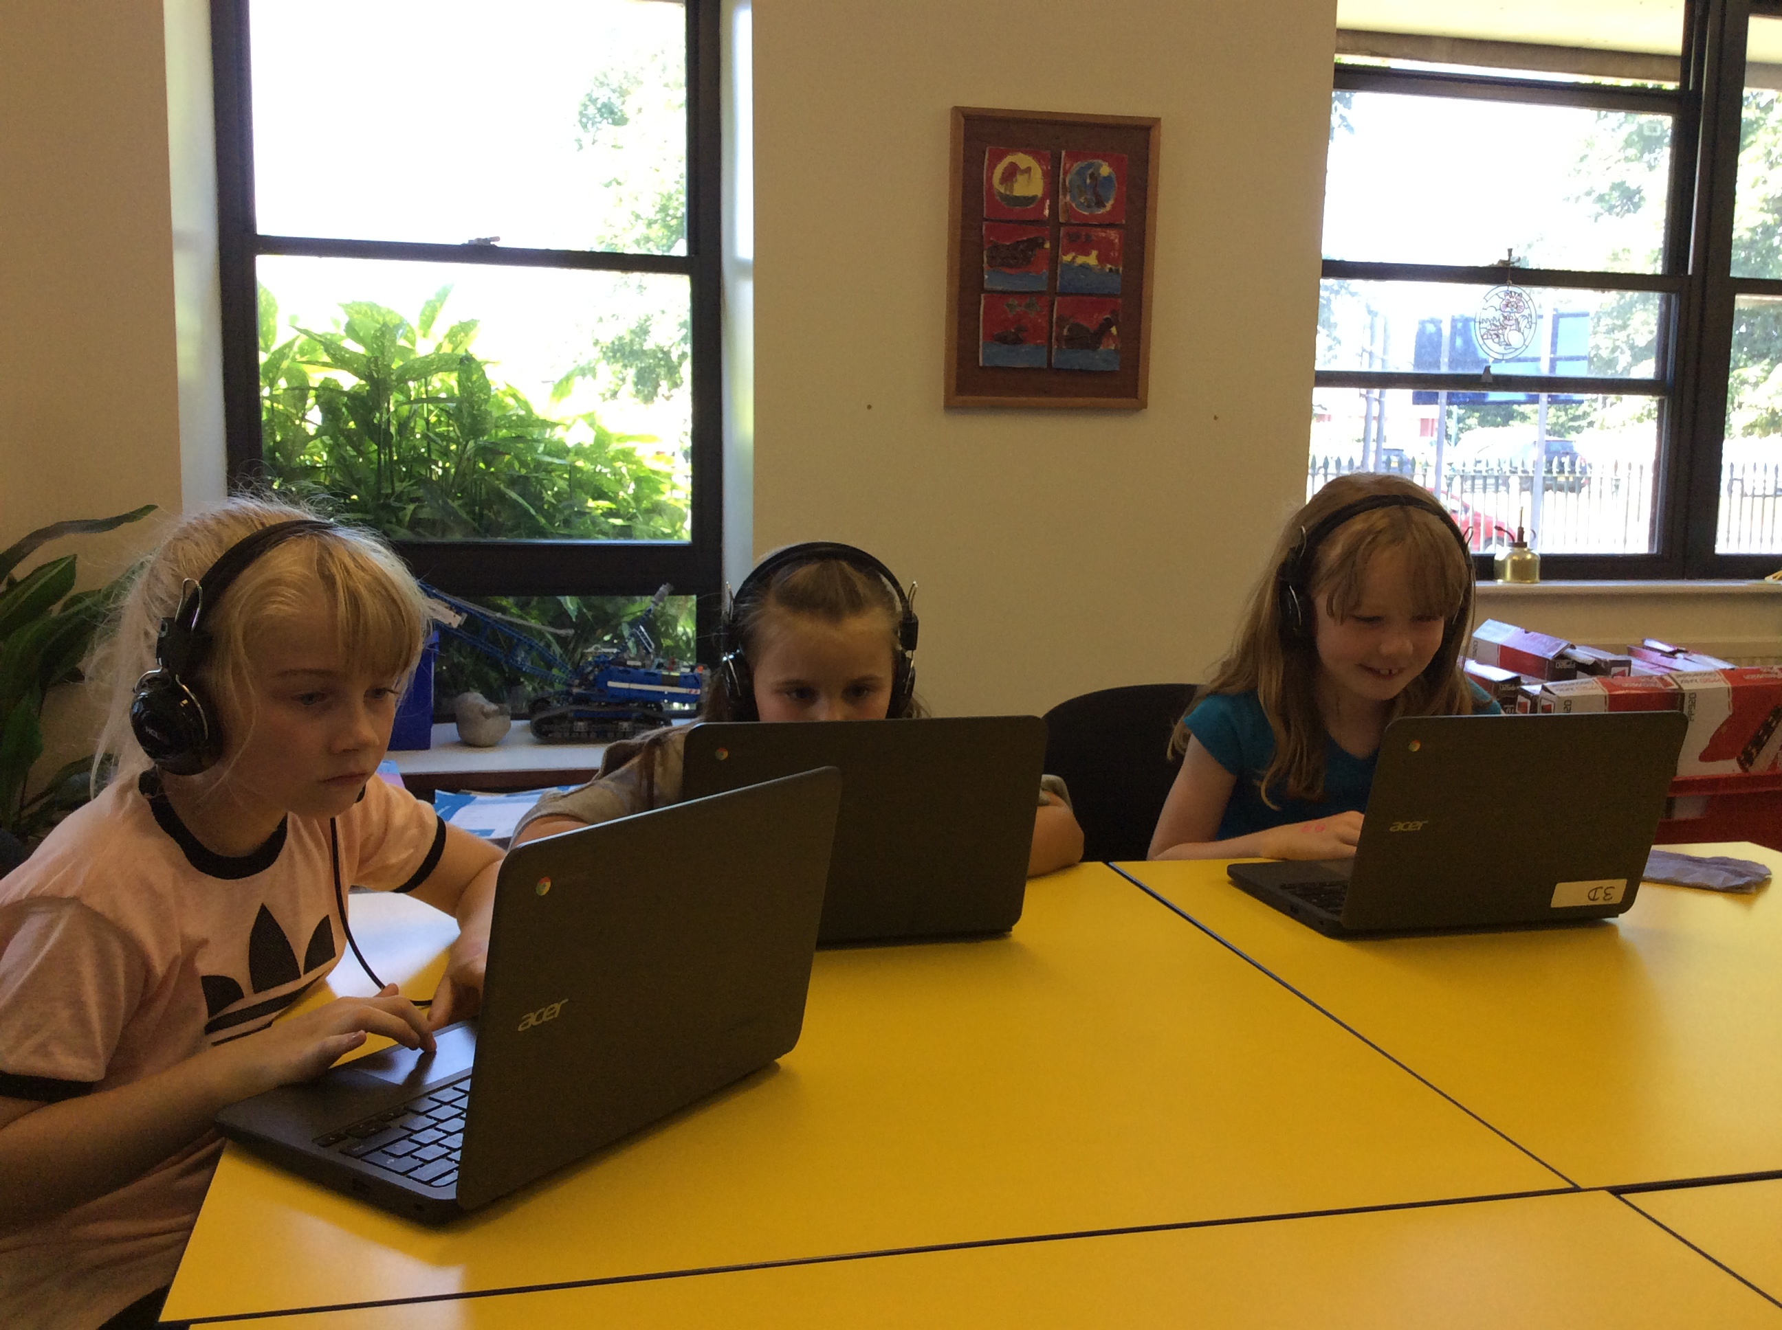
Reading Buddy in School
Reading Buddy will be used as part of a Guided Reading Carousel. Children will work as a focused group with a Teacher, reading together as a group. They can also access this independently using iPads and Chrome books.

Slide 22
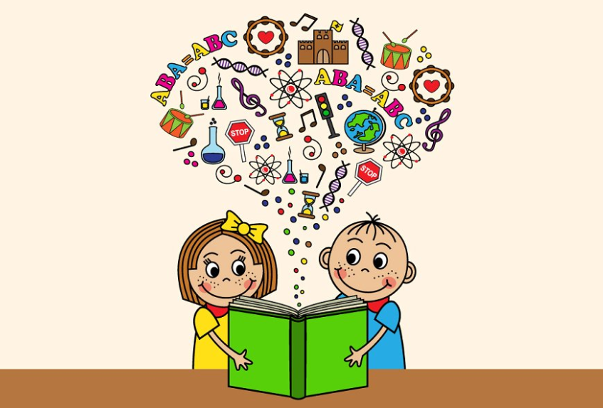
Reading Buddy in School
Pupils will still receive a reading book to take home each day, these are changed weekly.
We will still expect the pupils to read 5 times in a week, however do not have to only read their reading book, they can read ebooks as well as library books, or any books you have at home.
Can you please make a note of any of these books in their reading record as we will reward those children who have read 5 times for 10 consecutive weeks.

Slide 23
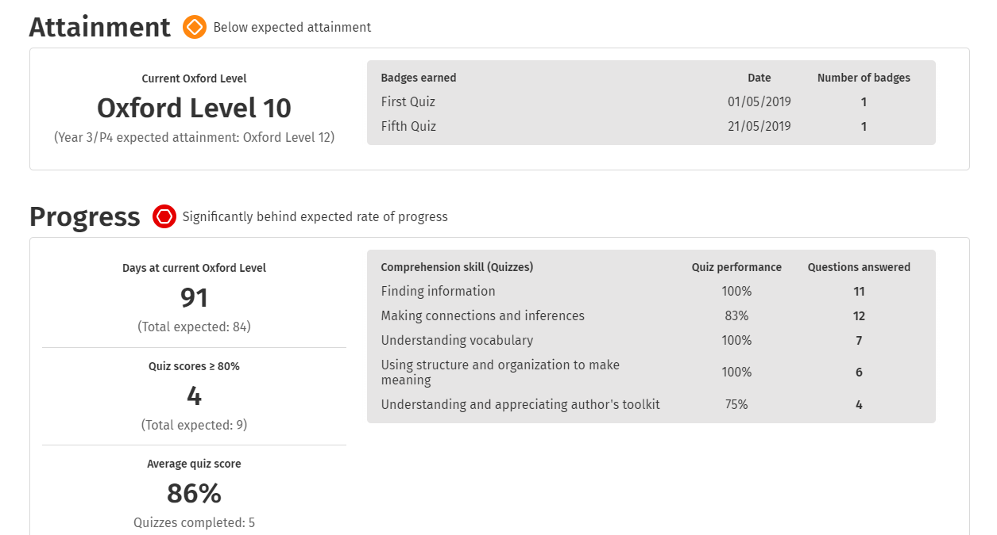
Reporting
All staff are able to create reports to see the children’s progress through their reading levels, how many badges they have earned, when they last logged in, quiz scores etc.

Slide 24
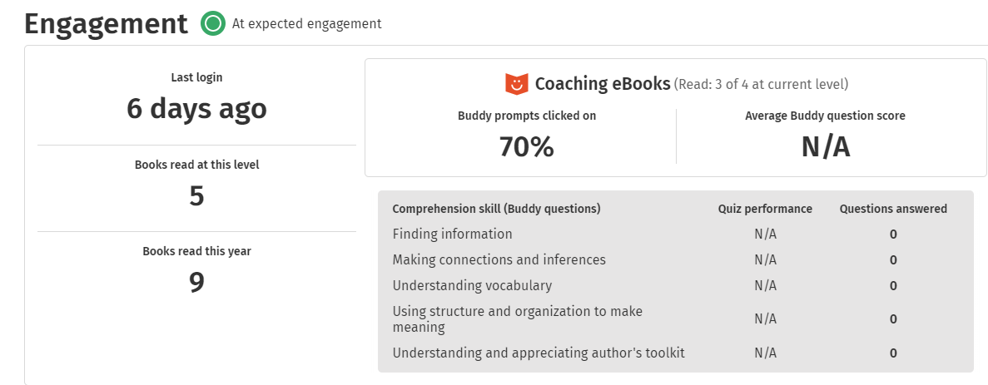
Reporting
We are also able to see their engagement levels e.g. last time they logged in, how many books they have read at each level and so far.

Slide 25
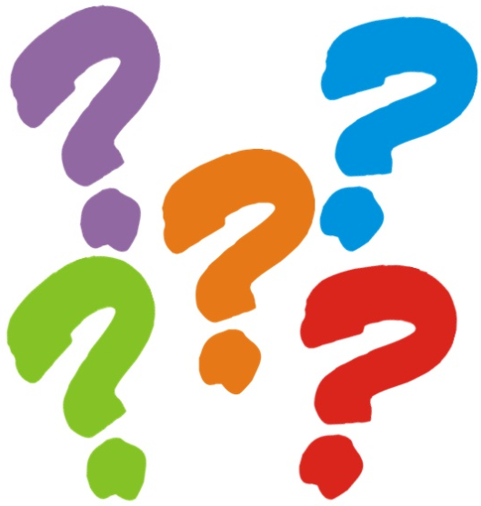
Questions
Thank you for listening.

