Slide 1
My AmeriCorps AmeriCorps Programs Create and Manage an eGrants Account
Notes:
Narrative from the tutorial:
Welcome to a demonstration of creating and managing an eGrants account. eGrants is the Corporation for National and Community Service’s (CNCS) grant application and reporting system. It is also the gateway to the My AmeriCorps system which allows users to manage their programs and members.
Please note that this does not apply to members, alums, and applicants as they use a different interface to apply for and manage their service. For more information, please view the tutorial titled, “My AmeriCorps Overview for Applicants and Members.”

Slide 2
eGrants User Account Set-up

Slide 3
User Roles and Overview
3
eGrants -only User Roles:
Grantee without access to budget
Has limited application information; no budget access.
Cannot assign user role.
Can authorize, assure, and certify.
Grantee with access to budget
Has access to entire application information, including budget information.
Cannot assign user role.
Can authorize, assure, and certify.
eGrants and My AmeriCorps User Role:
*Grantee Administrator
Has access to entire application, including budget information.
Can assign user role and update organizational information.
Can authorize, assure, and certify.
Has access to Portal functions for all programs, operating sites, and/or service locations.
3/26/13
Notes:
Narrative from the tutorial:
In eGrants, there are two user roles that cannot view My AmeriCorps functions:
Grantee without Access to Budget – this role has limited access to the application and cannot view the budget information.
Grantee with Access to Budget – this role has full access to the application
These two roles also cannot assign user roles and edit organizational profile in eGrants.
The Grantee Administrator has full access to the application as well the responsibility to assign user roles and updating the organization’s profile. This user role also has access to all My AmeriCorps functions for all programs, operating sites, and service locations. We recommend that each organization designate more than one grantee administrator to ensure that a administrator is available at all times to manage user roles and profile information.
All three of these roles can authorize, assure and certify the application. Therefore, the Authorized Representative of the organization can have any user role assigned to him or her and be able to complete the electronic signatures in the application.
However, the Authorized Representative must have his/her own account with which to logon to complete the sections in order for the system to recognize and register their name in the electronic signature fields.
Let’s now move on to the My AmeriCorps-only user roles.

Slide 4
User Roles and Overview
4
My AmeriCorps-only User Roles (these roles do not have access to the eGrants screens, except when noted):
*Grantee Administrator
This user role has both eGrants and My AmeriCorps functions. Please see previous slide for details.
Grantee Recruiter
Has access to all recruitment functions.
State/National Member Management
Applies to state and national grantees.
Has access to all member management functions, including user role management, for assigned programs, operating sites, and/or service locations.
**For additional information on My AmeriCorps user roles and access, please review the tutorial on User Roles and Management.
Notes:
Narrative from the tutorial:
To access My AmeriCorps functions through eGrants, a user must be assigned at least one of the following roles:
Grantee Administrator – this role has access to both eGrants and My AmeriCorps functions as well as manages user accounts and organizational information.
Grantee Recruiter – this role has access to all recruitment functions that include creating a service opportunity and process applications.

Slide 5
www.nationalservice.gov
5
3/26/13
Notes:
Narrative from the tutorial:
To begin, go to the main website for the Corporation for National and Community Service at www.nationalservice.gov. You will find the eGrants link located under the blue subject heading For Organizations. Click on the link to go to the eGrants page.

Slide 6
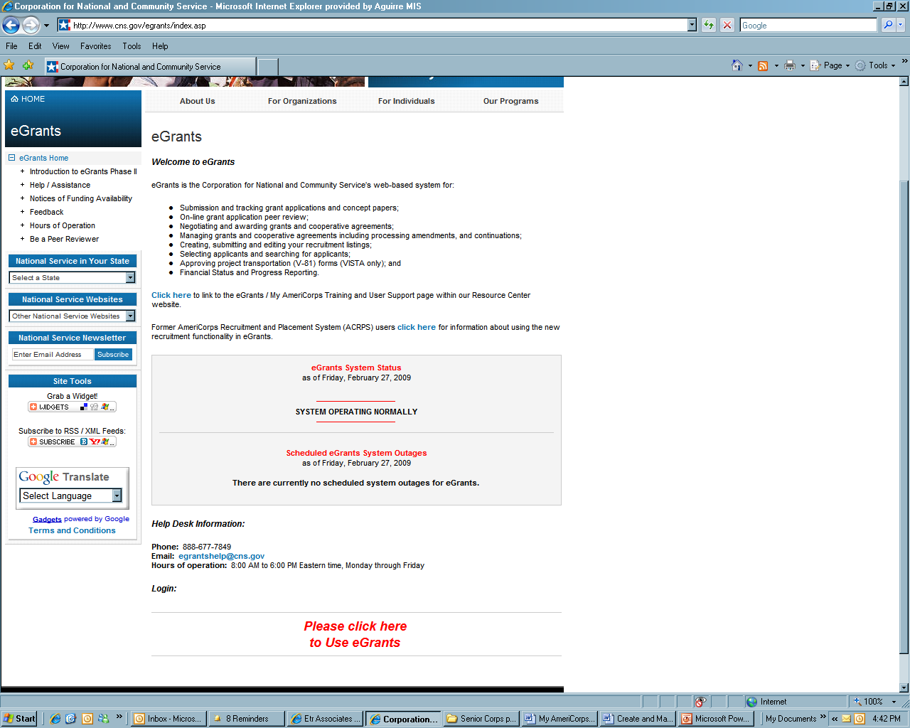
eGrants Page
6
3/26/13
Notes:
Narrative from the tutorial:
In the middle of the page, notice the eGrants system status notification box that will inform you of the system’s performance.
If you would like to save the link to your favorites, this would be the best link to save. The eGrants login page may go through URL changes from time to time.
Scroll down and click on “Please click here to use eGrants”. This will open a new web browser that takes you to the eGrants login page.

Slide 7
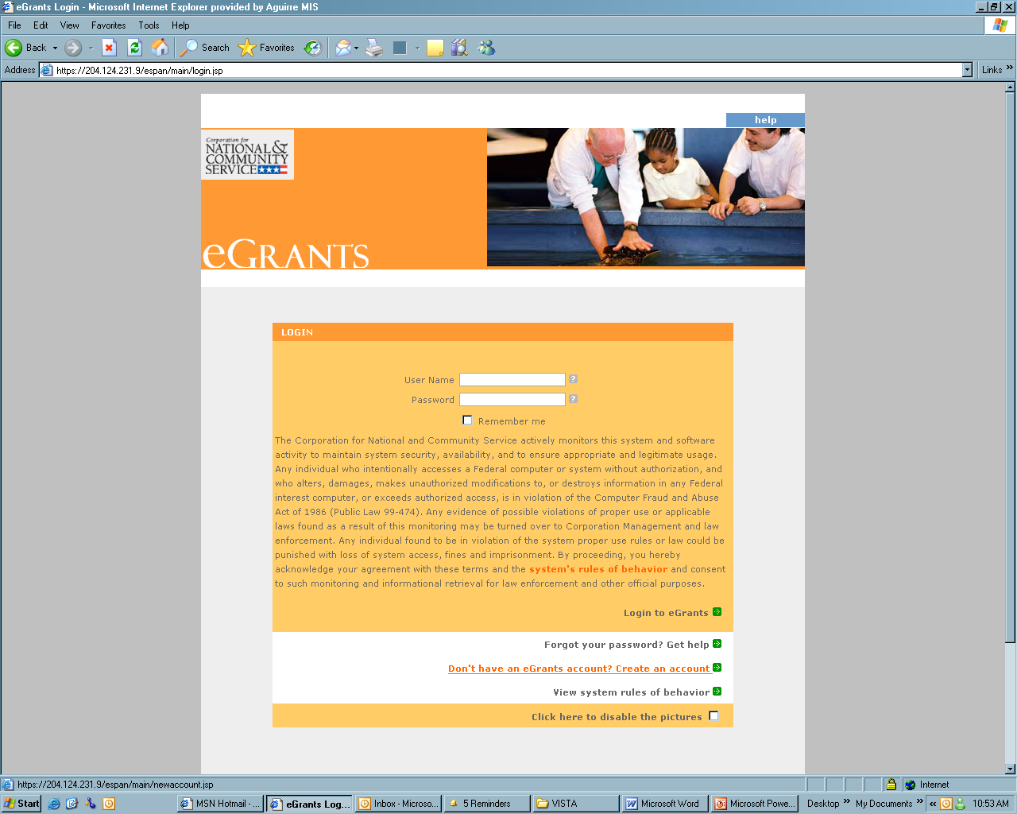
eGrants Login Page
7
3/26/13
Notes:
Narrative from the tutorial:
Save this page to your browser favorites to serve as a short cut to access eGrants here on out.
From this screen, click on “Don’t have an eGrants account? Create an account”.
Please note that if you already have an eGrants account for another CNCS program type – i.e. AmeriCorps or Learn and Serve –do not create another account. You will use the same account to create/complete all CNCS grant applications and to access My AmeriCorps. For programs with state and national grants or multiple national grants, users at the operating site or service location level of the national grant should have the AmeriCorps national legal applicant organization contact their Program Officer for specific guidance.
Also, if you already have an account, but do not remember your login information, please do not create another account in the system. Instead, contact the Help Desk and request your password to be reset.

Slide 8
Create a Grantee Account
8
3/26/13
Notes:
Narrative from the tutorial:
Click on “Create a Grantee account”. Please do not create a peer reviewer account.

Slide 9
Create a New Account
8
3/26/13
Notes:
Narrative from the tutorial:
On the next page, confirm by clicking on “This is my first time, I want to create a new account with eGrants”.

Slide 10
Login Information Page
10
3/26/13
Notes:
Narrative from the tutorial:
The next page you’ll see is the Login Information page:
Complete the Login Information to create your account. Enter your name, username, password, password question and answer, and email address. For security purposes your password must meet a list of criteria. Should you have any trouble with creating a password, click on the question mark next to the field to see the help menu.

Slide 11
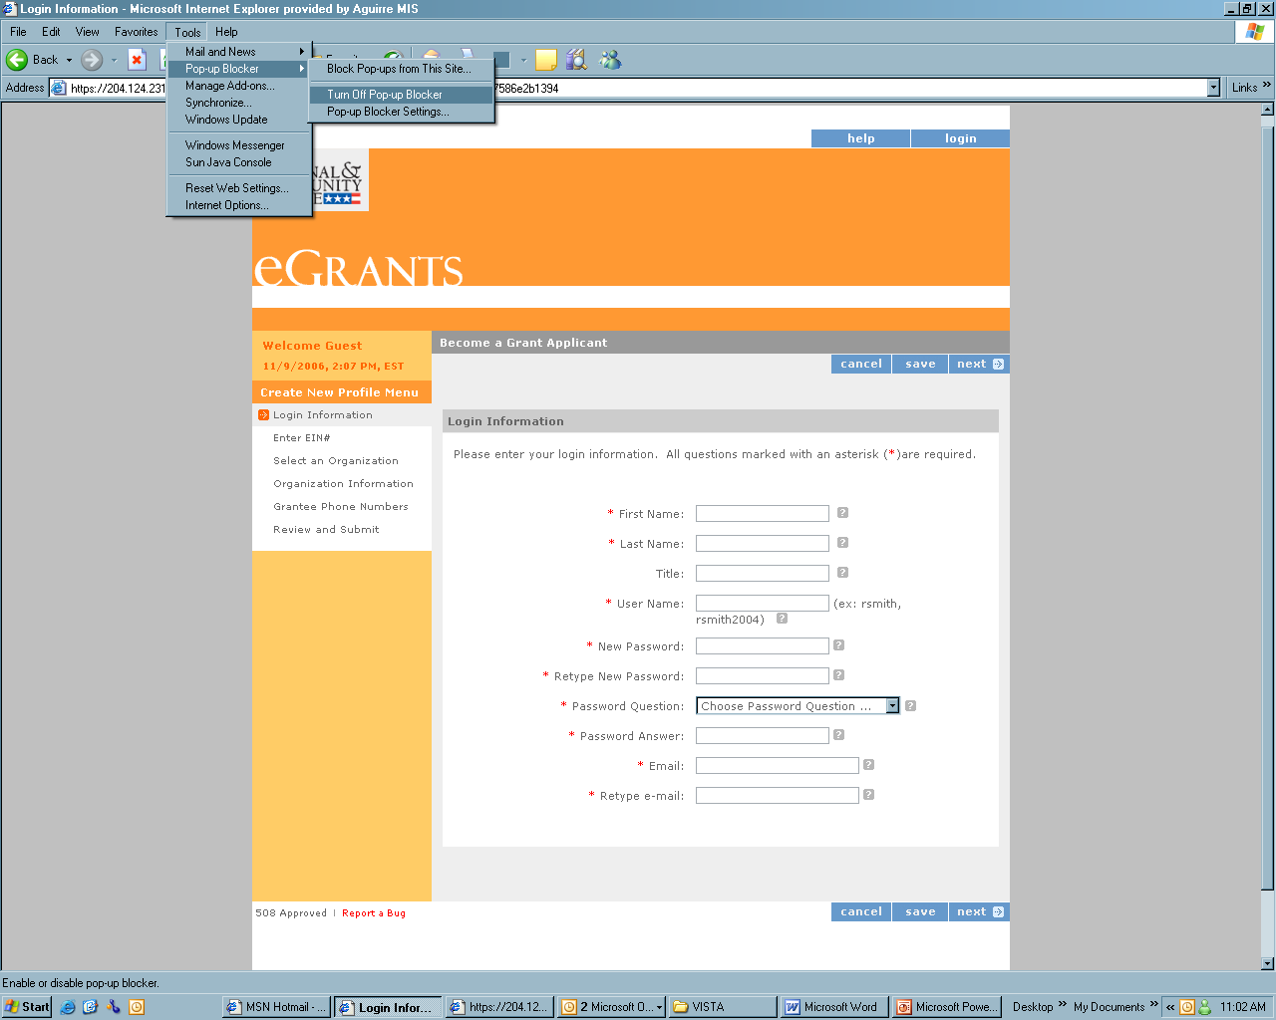
Turn off Pop-up Blocker
11
3/26/13
Notes:
Narrative from the tutorial:
Please make sure any pop-up blockers are turned off prior to clicking on the menu link since the system will open a secondary window for the menu.
Go to the Tools menu and point to Pop-up Blocker and make sure that it is turned off.

Slide 12
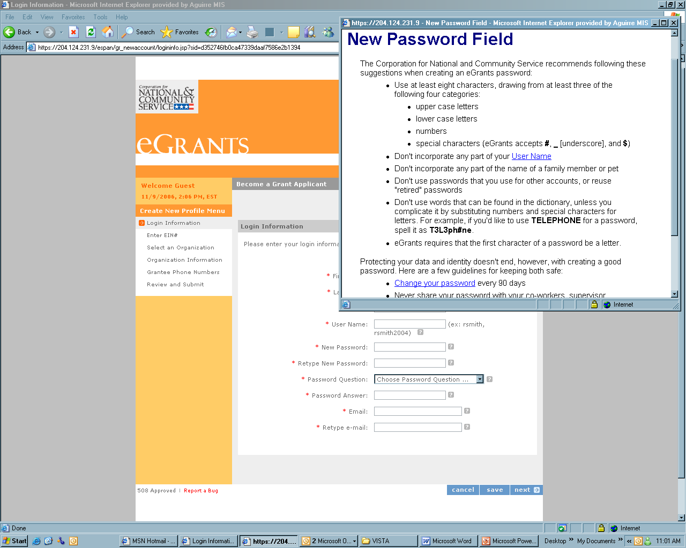
Help Menu for Password
12
3/26/13
Notes:
Narrative from the tutorial:
Here is the help menu pop-up which offers tips and suggestions when choosing your password.

Slide 13
Complete Required Fields
13
3/26/13
Notes:
Narrative from the tutorial:
The Password Question and Answer fields must also be completed. Should you forget your password when logging in later, there is a “Forgot Password” link on the login page that you can follow to reset it. The system will send an email reminder to the address that you provide on this page.
Please note that as you try to log in later you must select the same security question to answer. If you forget your password question and attempt to go down the list to answer each one, the system will lock up your account after 3 unsuccessful attempts. Once your account is locked, you must contact the Help Desk to have it unlocked.
Once you have completed the Login Information page, click on “Next”.

Slide 14
Enter EIN
14
3/26/13
Notes:
Narrative from the tutorial:
On the EIN page, enter the Employer’s Identification Number; again this is also known as the taxpayer’s ID number.
For State Commission sub-grantee users, please enter the EIN for your program or legal applicant name.
Again, as mentioned earlier, for programs with state and national grants or multiple national grants, users at the operating site or service location level of the national grant should have the AmeriCorps national legal applicant organization contact their Program Officer for specific guidance.
Then click next.

Slide 15
Select Your Organization
15
3/26/13
Notes:
Narrative from the tutorial:
The system will give you a list of organizations that have the same EIN as your organization.
Please do not select Create a new organizational profile for the EIN. If you choose this option rather than linking to an existing organizational profile, you will not be properly connected to the awarded grant.
Instead, scroll down to find the organization to which the grant was awarded and select it from the list. It is crucial that you select the exact spelling and punctuation of the legal applicant name as it is listed in grant application of the awarded program. Choosing an incorrect one will place your request in the incorrect organizational profile. If you are unsure of which organization to select, please stop the process here and contact your Program Officer or State Office staff for further guidance. Click next.

Slide 16
Organization Information
16
3/26/13
Notes:
Narrative from the tutorial:
And the Organization Information page will be displayed with the information already listed.
Please confirm that the organizational information is correct. If the information needs to be changed, you must contact the Grantee Administrator of the organization. If everything is correct, click next.

Slide 17
Enter Your Contact Numbers
17
3/26/13
Notes:
Narrative from the tutorial:
Now you will enter your contact phone numbers. The only required phone number is the Daytime number. Click next.

Slide 18
Review and Submit Account Request
18
3/26/13
Notes:
Narrative from the tutorial:
Review the information, make any needed changes and click Submit.

Slide 19
Account Request Confirmation Page
19
3/26/13
Notes:
Narrative from the tutorial:
Once you have submitted your account creation request, you should receive a Thank You confirmation note letting you know that the Grantee Administrator has been notified.
There may be more than one grantee administrators listed if the role is shared with multiple people in the organization. If you would like to send a personal email to the grantee administrator, click on the person’s name to open a blank email addressed to that person.

Slide 20
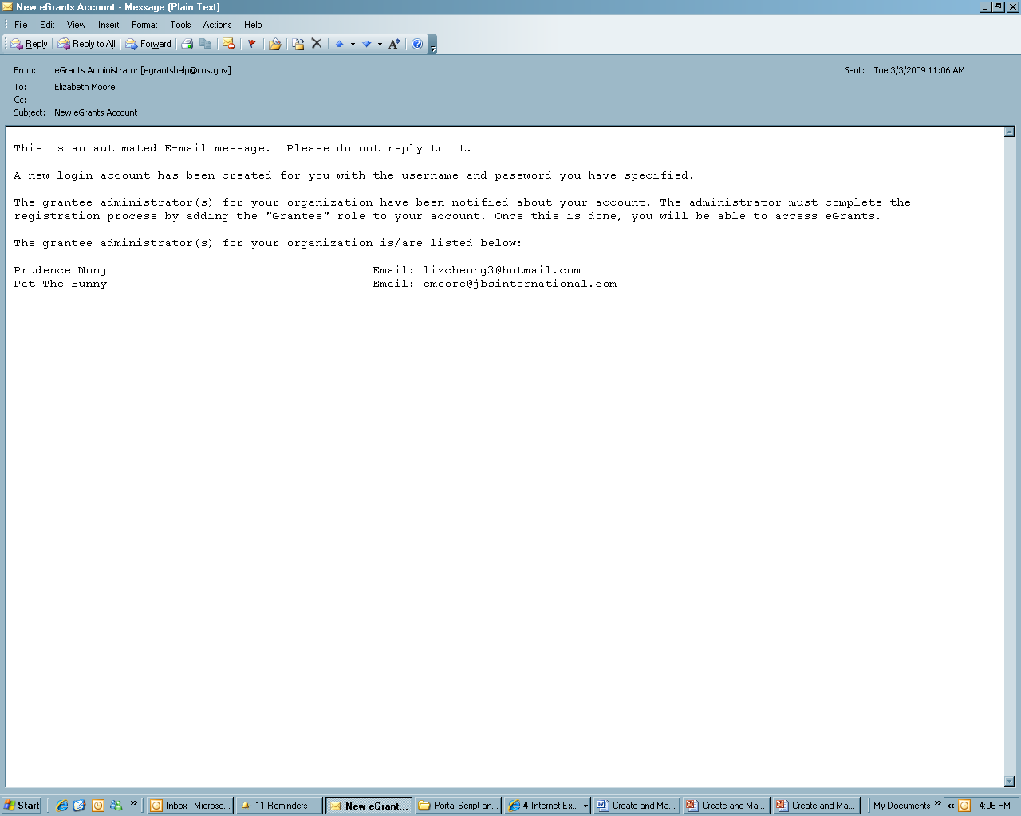
Email to Account Requestor
20
3/26/13
Notes:
Narrative from the tutorial:
At this point, the system will also generate two email messages, one to you and one to the grantee administrator.
An email like this will be sent to you confirming that you have created an account and are requesting the grantee administrator to grant you access.

Slide 21
Grantee Admin.’s Home Page
Click on My Account to open the account information page.
eGrants Coaching Unit
Notes:
Narrative from tutorial:
We are looking at the Grantee Admin’s home page. The Grantee Admin is responsible for assigning user roles. Therefore if you need to be assigned a user role, you must contact the Grantee Admin of your legal applicant organization. Your Grantee Admin will assign to you an appropriate user role based on your job responsibilities. For details on user roles, please view the tutorial on User Roles and Management – Understanding Planning (Part I).
To assign a user role, the grantee administrator should go to the account information page by clicking on My Account.

Slide 22
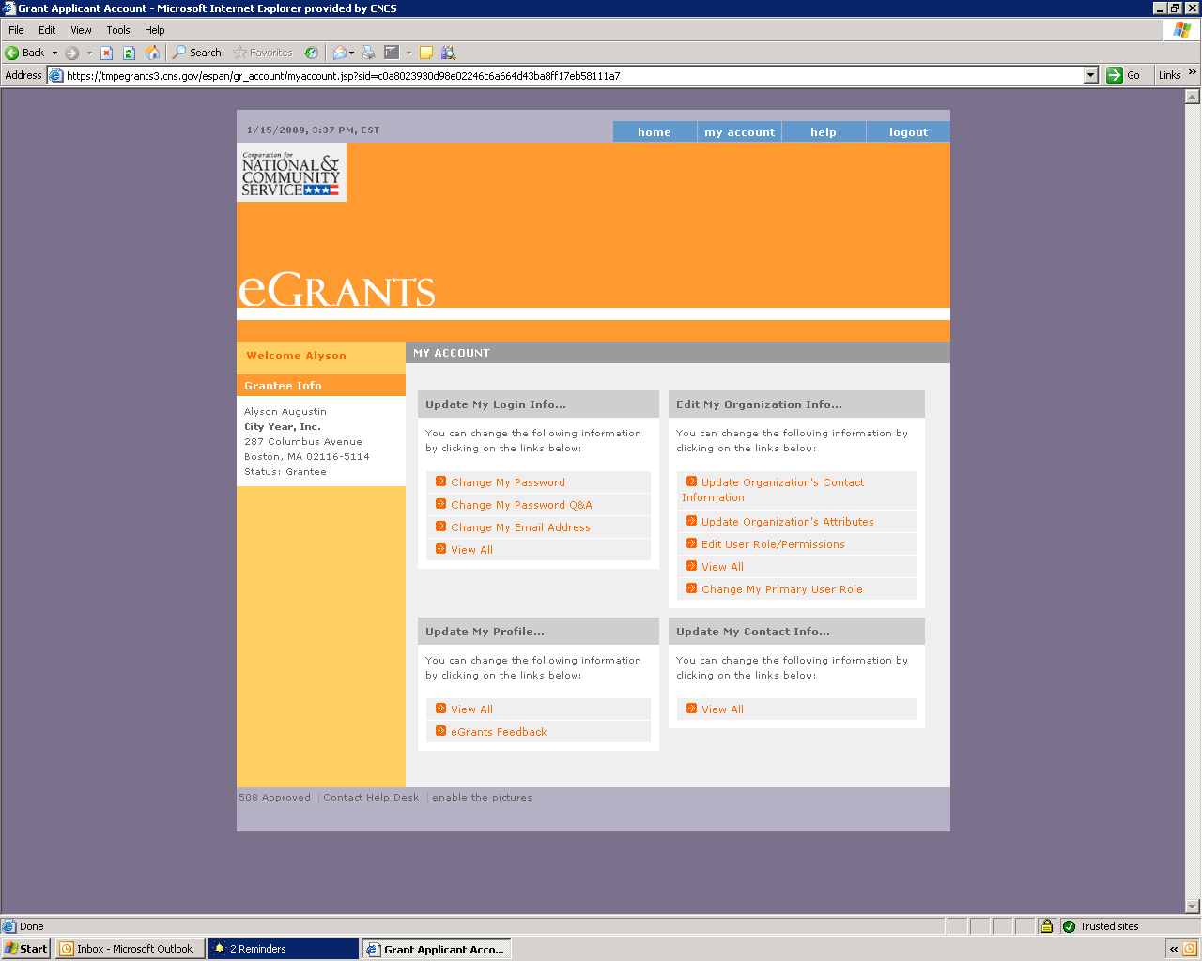
My Account Page
Click on Edit User Role/Permissions to assign user role(s).
eGrants Coaching Unit
Notes:
Narrative from tutorial:
and then click on Edit User Roles/Permissions.

Slide 23
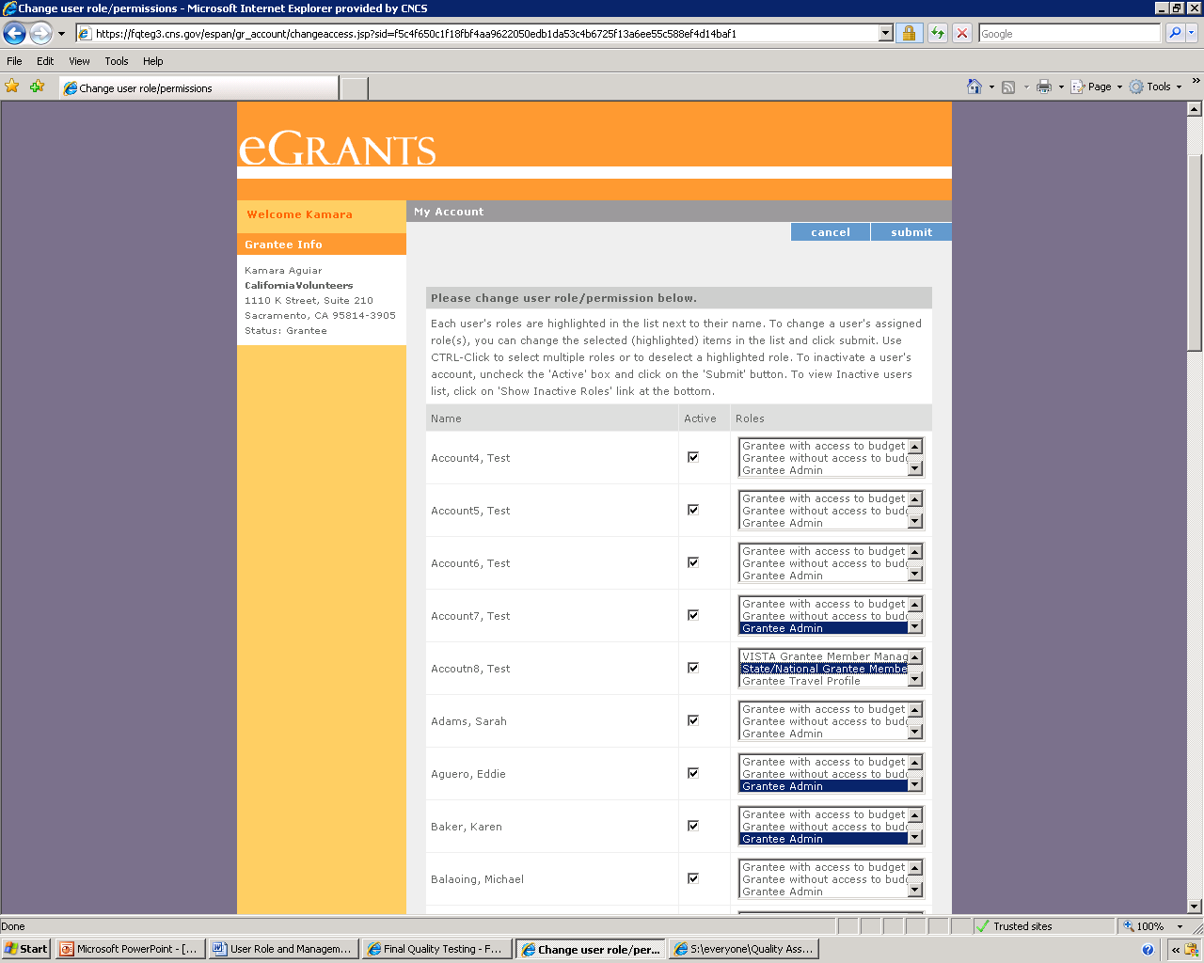
Assign User Role(s)
To add multiple roles, press and hold the “crtl” key on your keyboard and click with your mouse.
Highlight the appropriate user role(s) and click submit.
eGrants Coaching Unit
Notes:
Narrative from tutorial:
To the right of each name, you will see a box that contains a list of user roles. Go down the list using the scroll bar on the right and highlight all applicable user roles. To make multiple selections press and hold the “ctrl” button on your keyboard and use the mouse to highlight. Click submit to save the changes.

Slide 24
Confirmation Page
User Role assigned.
eGrants Coaching Unit
Notes:
Narrative from tutorial:
The next page you’ll see is a confirmation page of the role(s) added. If Grantee Admin. assigns someone the Grantee Member Mgmt. role, he/she will also need to designate a level of access. Assigning this access level is crucial because without it, this user will not be able to perform any functions in My AmeriCorps.
To assign an access level, we have to go back to the home page by clicking the blue tab marked home on the top left of the screen. Only if a user is granted the Grantee Member Management user role would he/she needs to be assigned an additional access level.

Slide 25
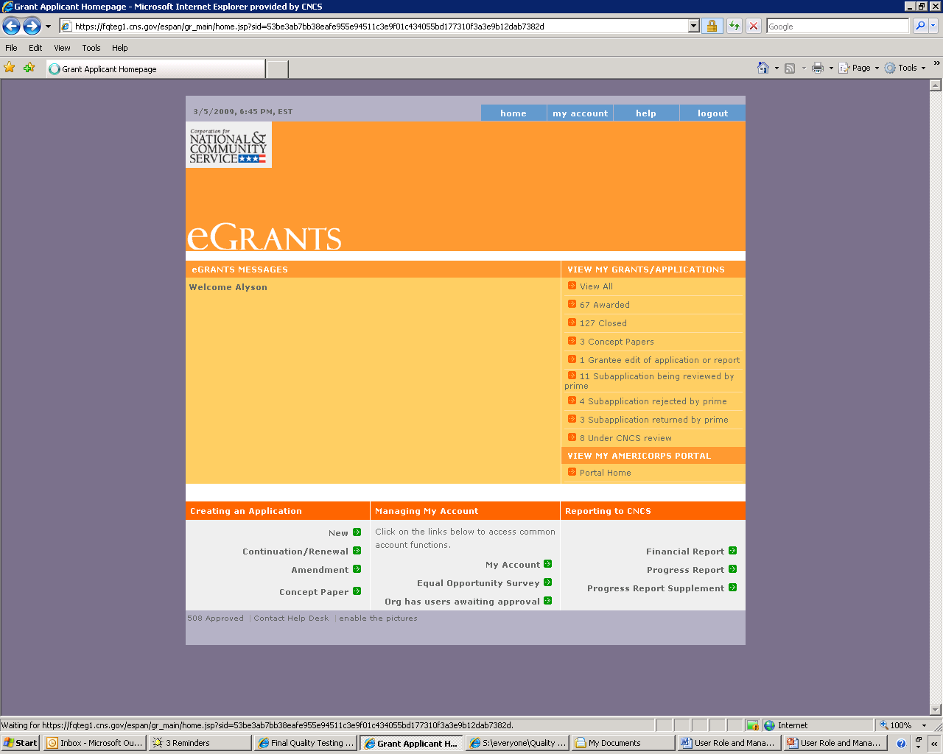
Back to Home Page
Click Portal Home.
eGrants Coaching Unit
Notes:
Narrative from tutorial:
From the home page, go to the My AmeriCorps functions by clicking the Portal Home link.
As reminders from Part I of the User Roles module, Understanding and Planning:
In the state commission context, the three access levels are prime, operating site, and service location. A prime refers to a grant; an operating site refers to a program; and the service location refers to the exact location where a member serves. These are also authority levels of users. User access does not have to align with staff position. For example, a staff member in charge of data entry at the state commission or a program can be assigned to the Service Location level to initiate forms.

Slide 26
S&N Workbasket Page
Click on Manage Users.
eGrants Coaching Unit
Notes:
Narrative from tutorial:
This is the S&N Workbasket page that details the pending items awaiting approval. To assign a level of access, click Manage Users on the left hand navigation.

Slide 27
Manage Users Page
Click on the orange links to sort in ascending or descending order.
Click on the user’s name to assign access.
eGrants Coaching Unit
Notes:
Narrative from tutorial:
You will see a list of all active member management users listed in alphabetical order. If you have multiple pages, you can navigate through them either by clicking on the numbers or the next and last links located on the upper right corner. To view by Username or Name, click on the corresponding orange link to sort in ascending or descending order.
Click on the name of the person to assign access.

Slide 28
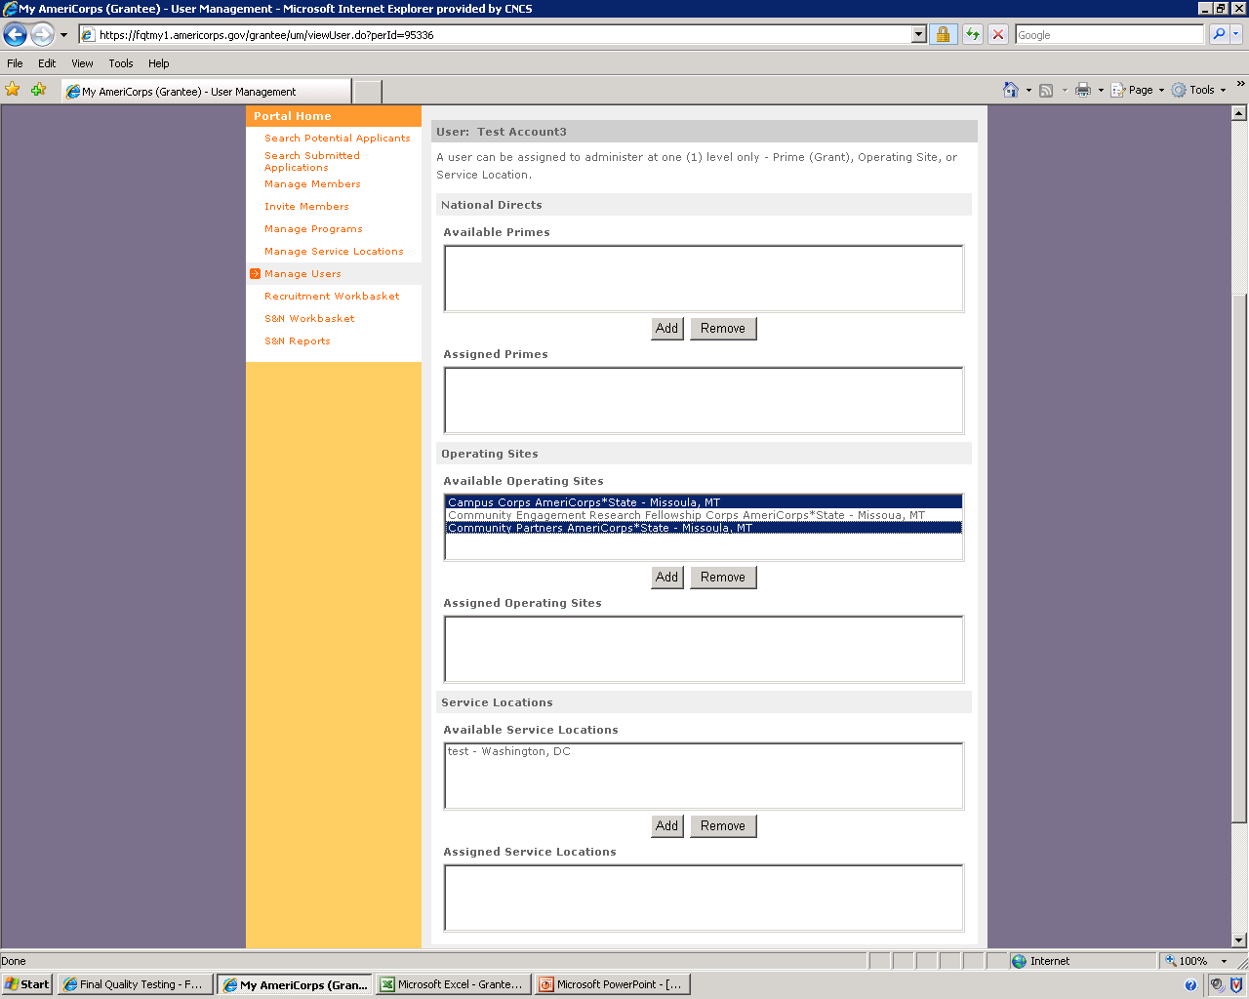
Add Operating Site Level for a Sub-grantee User
eGrants Coaching Unit
Notes:
Narrative from tutorial:
Again, the prime level would not apply to the program, so there would not be any listings under Prime. The levels that would apply are the Operating Site and Service Location. Please refer to the User Roles Map for actions that these roles can perform. Moreover, though the sub-grantee would also have Grantee Admins at their legal applicant organization, they check with their Program Officer for guidance on business practices.
To assign, simply highlight the appropriate item(s) within the Operating Site or Service Location level of access and click Add.

Slide 29
Member Recruitment

Slide 30
Member Recruitment Workflow
30
Grantee Recruiter
create/edit Service Opportunity Listings
CNCS Recruitment Administrator
process and post listings
Applicants
search for listings, register, & apply to serve
State/National Grantee
view &accept applications, extend offer to serve
Applicants
accept offer to serve & complete Part 1 of the enrollment form
eGrants Coaching Unit
Notes:
Narrative from tutorial:
As you will notice from this workflow overview, a grantee recruiter will create a service opportunity listing.
After the service listing is created, a CNCS Recruitment Administrator will approve and post it. This process usually takes about 48 hours, but will require additional time during high recruitment season.
An interested applicant will search for listings, register and apply to serve.
Once an applicant submits an application, state/national grantee will view and accept the application and extend an offer to serve.
Applicants will then accept the offer to serve and complete part 1 of the enrollment form (Enrollment Information Section).

Slide 31
Create a Service Opportunity Listing
31
Click on the Portal Home link to open up the Portal Home page
eGrants Coaching Unit
Notes:
Narrative from tutorial:
To begin the process of creating a service opportunity, click on the “Portal Home” link on your eGrants welcome page to open the main page.

Slide 32
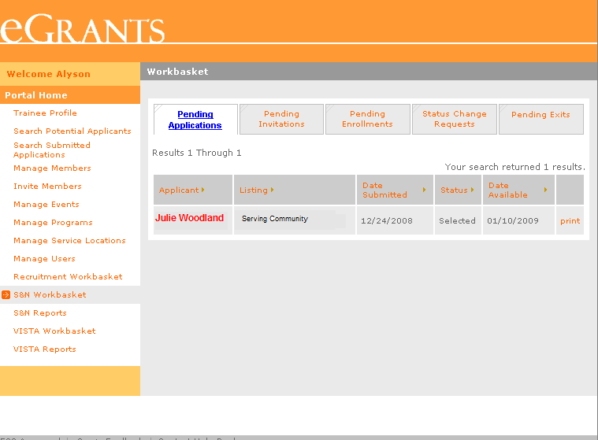
Create a Service Opportunity Listing
32
Click Recruitment Workbasket on the left navigational panel
eGrants Coaching Unit
Notes:
Narrative from tutorial:
Click on the “Recruitment Workbasket” link on the left navigational panel. Portal users with “Grantee Recruiter” role or “Grantee Administrator” role will have access to this link on the Portal Home page.

Slide 33
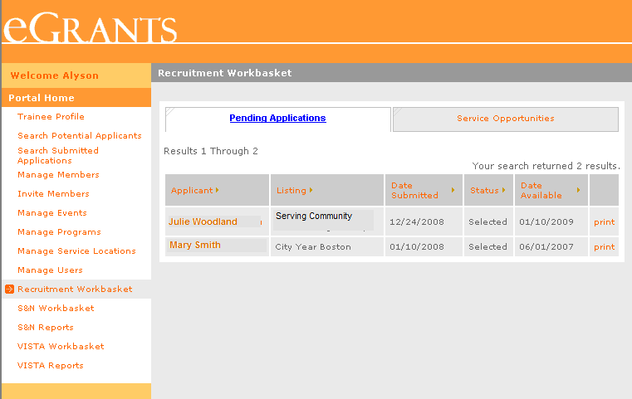
Create a Service Opportunity Listing
33
Click on the Service Opportunities tab
eGrants Coaching Unit
Notes:
Narrative from tutorial:
Click on “Service Opportunities” tab to open the My Service Opportunities listing page.

Slide 34
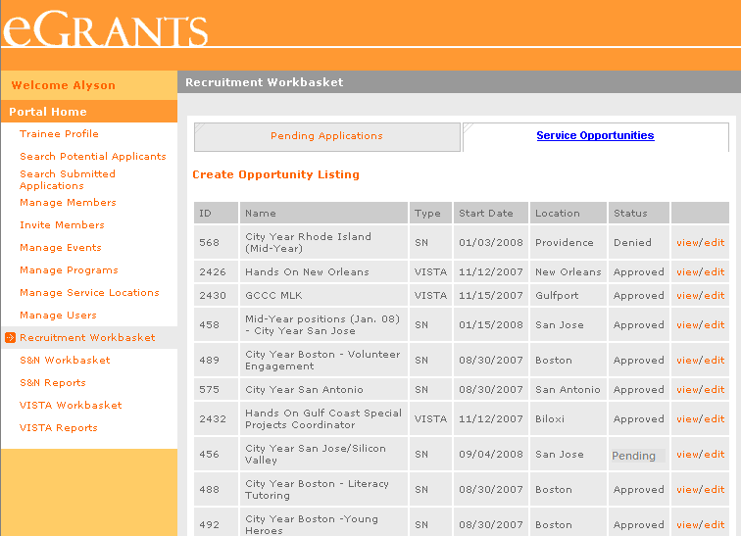
Create a Service Opportunity Listing
34
Click on Create Opportunity Listing
eGrants Coaching Unit
Notes:
Narrative from tutorial:
Click on “Create Opportunity Listing” link. This will open up the first of a three screen process to enter information to create the service opportunity.

Slide 35
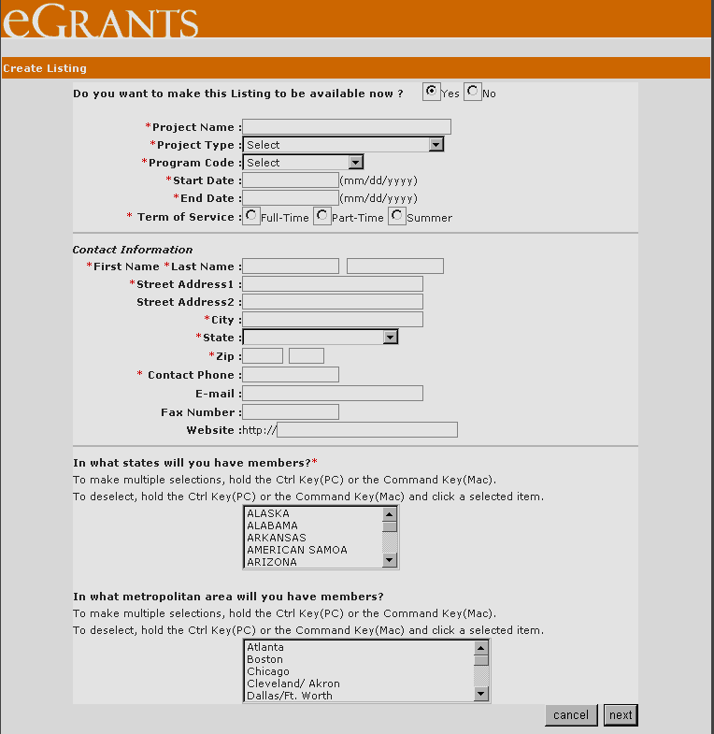
Create a Service Opportunity Listing
35
If you choose Yes your listing will be available to potential applicants once it is approved by the CNCS Recruitment Specialist
Screen 1
Select the Project Type from the dropdown menu
Enter the email address correctly. Notifications of applications submitted will be sent to this email address
Clicking on Next doesn’t save the data. Data won’t be saved until you click Save on Screen 3
Click Next to go to the next screen
eGrants Coaching Unit
Notes:
Narrative from tutorial:
On this first screen, select “yes,’ if you want the listing to be available right away once the CNCS Recruitment Administrator approves it.
Enter and select information about the project: project name, type, code, start and end dates, and the term of service you’re offering.
Enter the contact information of the person who will be managing the listing. Make sure you enter the email address correctly as all the notifications of application submissions will be sent to this email address.
Select the states and metropolitan area you’ll have the members in using the dropdown menu. You can make multiple selections by holding your control (ctrl) key while making your selections.
Click on “next” to advance to the next screen. But remember clicking on next doesn’t save your data. Your data will be saved only when you click “save” on the 3rd (last) screen.

Slide 36
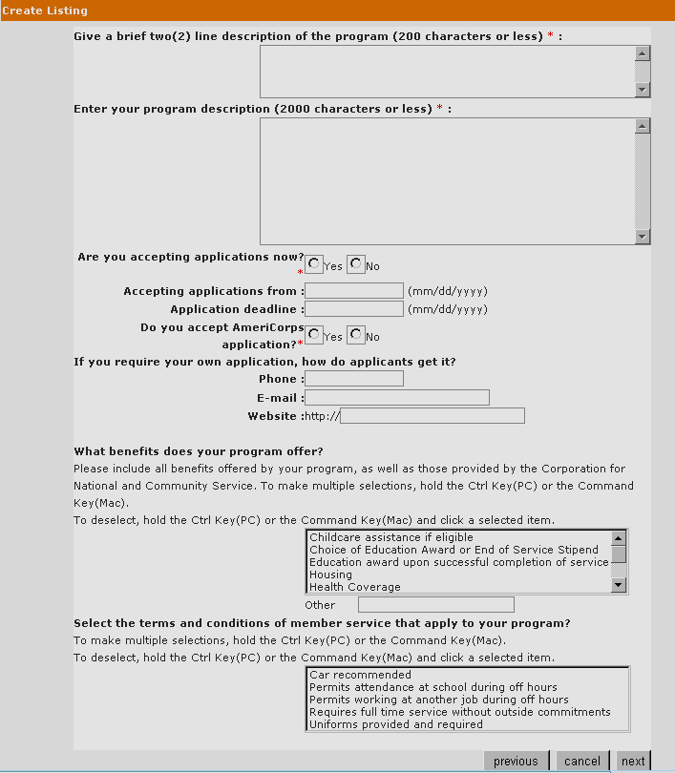
Create a Service Opportunity Listing
36
All text must be within the defined character limits. Spaces and punctuation are counted as characters
Screen 2
Indicate whether or not you are accepting applications now, the dates you will accept them, and whether or not you will be accepting AmeriCorps applications
If you click Previous, it will take you to the previous screen but you will loose data entered on this one
eGrants Coaching Unit
Notes:
Narrative from tutorial:
Enter a brief description of the listing. You need to make this description clear and compelling as this will be the first information an applicant or member will see when they are searching for service opportunities in My AmeriCorps.
Enter a more detailed description of the service opportunity. When you enter descriptions, make sure your text is within the defined character limits. In eGrants spaces and punctuations also count as characters. We recommend that you create this information initially in a word processing application such as Microsoft Word which will allow you to check the character count as well as the spellings prior to posting. It is also suggested that once you create your listing in Microsoft Word, you cut and paste it into Notepad because at times Microsoft Word adds hidden characters to text and that text appears as special characters. When you cut and paste from Notepad to the portal, no special characters are incorporated into your text.
Indicate how long applications will be accepted and if the AmeriCorps online applications will be accepted.
Enter the requested information, if you are accepting your own applications for this listing.
Select the benefits your service opportunity will offer and conditions of service. If you need to make multiple selections, hold down your control (ctrl) key while making your selections.
Click on “next” to advance to the next screen. If you click “previous” it will open up the first screen but you will loose the data entered into this screen. Therefore, if you want to go to a previous screen to edit information, wait until you click on “save” on the third screen.

Slide 37
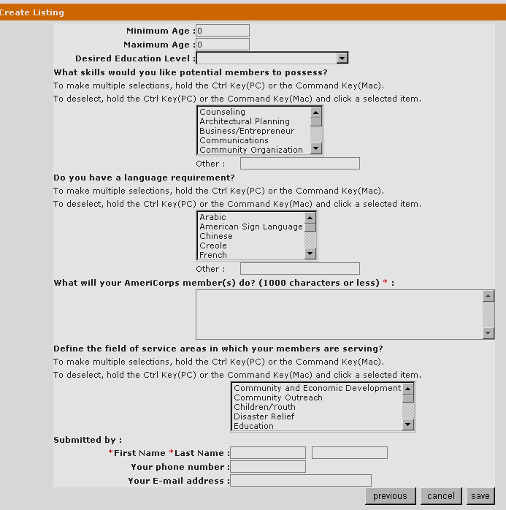
Create a Service Opportunity Listing
37
If you click Previous, it will take you to the previous screen but you will loose data entered on this one
Screen 3
If you click Cancel, it will not save the listing
When you click Save, the listing will be submitted to the CNCS Recruitment Administrator for approval and will be displayed in Read Mode
eGrants Coaching Unit
Notes:
Narrative from tutorial:
Enter age, education level, skill sets and language requirements.
Then enter what you expect your members to do during their service.
Select the field of service your members will serve in.
And finally enter your contact information.
If you click “save,” the service listing will be submitted to the CNCS Recruitment Administrator for approval and it will open in reading mode for you to view.
If you click “previous,” it will open up the previous screen but you will loose the data entered in this screen.
If you click “cancel”, it will remove the listing.

Slide 38
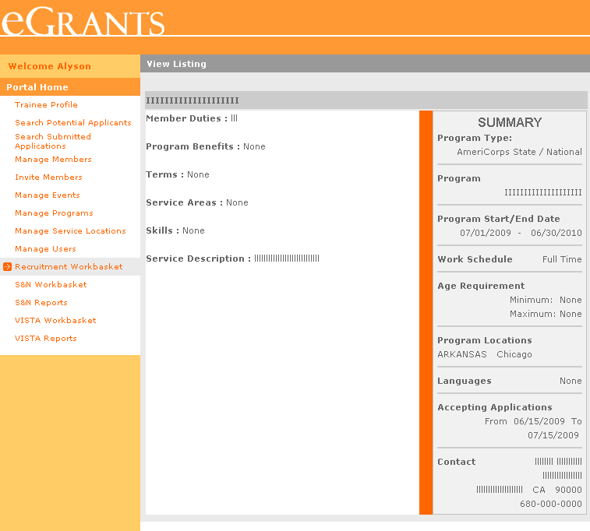
Create a Service Opportunity Listing
38
When you save a listing, it will open up a summary page for that particular listing
Click Recruitment Workbasket to view the Service Opportunity Listings
eGrants Coaching Unit
Notes:
Narrative from tutorial:
This is how the listing summary will appear in read only mode after you hit “save.”
Your listing will now appear under My Service Opportunities in the Recruitment Workbasket.

Slide 39
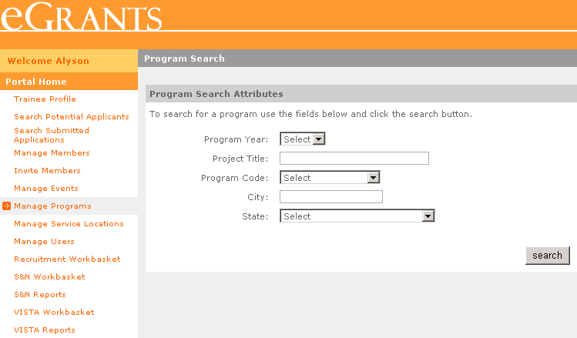
Creating a Service Location
39
Select and/or enter identifying information to start a search. Click on search to see the results.
eGrants Coaching Unit
Notes:
This is the Program Search screen. You can use this form to find a single, specific Operating Site, or Sites that fit the criteria you select. None of the fields are required, but you can narrow your results by entering more criteria.
For example, if you want to see all Operating Sites from a single grant year, select only the grant year; if you want to see all years’ data for a single Operating Site, enter the Project Title or Program Code.
You have to go through this screen even if you have access only to a single Operating Site—but of course in that case, you could leave all the fields blank and just click the search button.
39

Slide 40
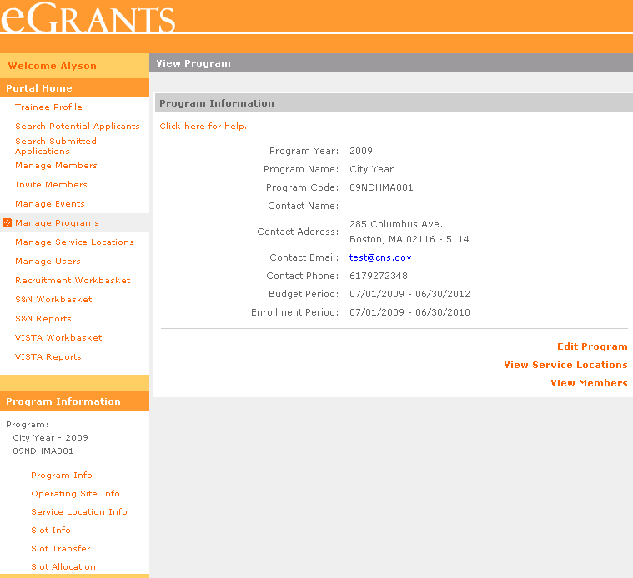
Program Information Screen
40
Information about the Program and links to perform other tasks.
The Program Information links provide quick access to perform other grant-related functions and are specific to the program listed.
eGrants Coaching Unit
Notes:
After you select the Grant or Operating Site by clicking its name, you will see the Program Information Screen.
In this example, we clicked on the name of an Operating Site on the search results screen.
I’d like to call your attention to the additional set of links on the left. The Program Information links provide quick access to perform other grant-related functions and are specific to the program listed.
The specific links displayed will differ according to your access level.
We’re going to go through all of these links in this demonstration.
40

Slide 41
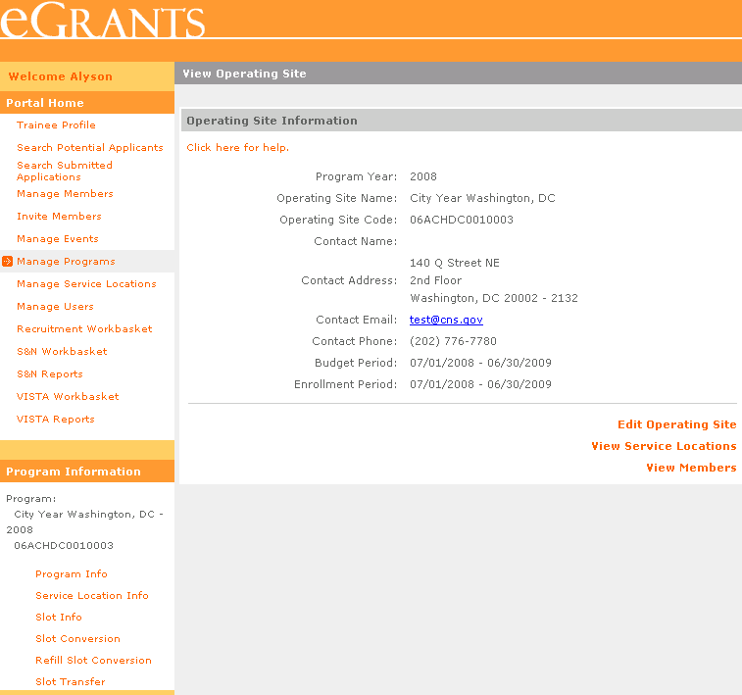
Service Locations
41
Use the View Service Locations link or the Service Location Info link to view a listing of the Service Locations assigned to the Operating Site.
eGrants Coaching Unit
Notes:
The service location feature in My AmeriCorps provides a way to group members by where they serve.
A Service Location is what has previously been generally labeled a sub-site.
Using Service Locations is optional, but it will allow you to create reports on the number of members serving at a location and will allow programs to assign My AmeriCorps users at the service location who have less authority in the system. You will find this feature most beneficial for community level and ad hoc reporting. Although assigning members to a service location is optional, your CNCS Program Officer or your State Commission may require its use. (The Reports tutorial provides more information on the reports available through My AmeriCorps.)
View Service Locations by clicking on the Service Location Info link on the left side or by clicking the View Service Locations link from the Operating Site Information page.
41

Slide 42
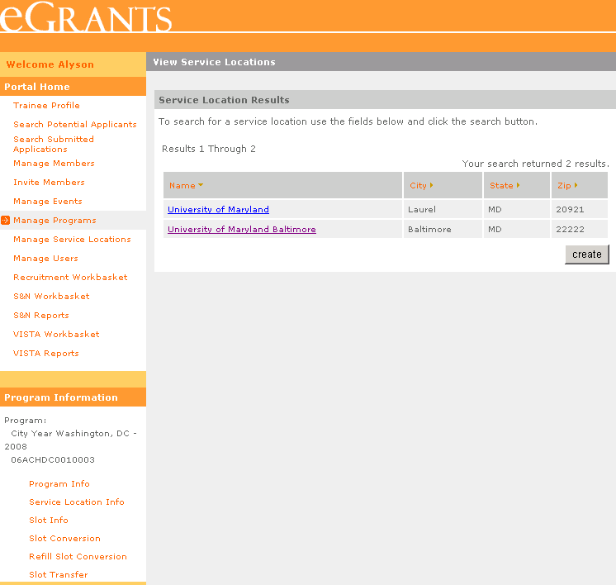
Service Locations
42
The total number of service locations and a listing of the service locations assigned to the Operating Site is displayed. Click on create to enter a new service location.
eGrants Coaching Unit
Notes:
The service locations listing page displays the total number of service locations and a listing of the service locations assigned to the Operating Site. The listing can be sorted by clicking on the column title.
If there are no service locations listed, a new one can be created. We will demonstrate how by clicking on create.
42

Slide 43
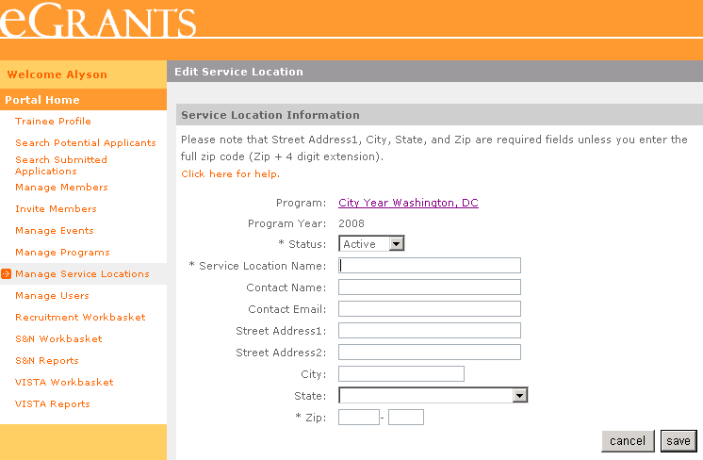
Service Locations
43
Select and enter information about the service location. Click on save to keep the information or cancel to discard it.
eGrants Coaching Unit
Notes:
The service location is associated with the operating site is listed on the Operating Site Info page.
The program and program year fields are not editable. Select the status of the service location— note: you must select active status if you want to be able to assign members to the service location.
Enter the contact information for the service location. Service locations will be available for all program years sharing the same program code.
A service location name and the five-digit plus-4 zip code are required.
Click on save to create the new service location or cancel to discard the information and return to the service locations listing page.
We will save the new service location. If any errors are encountered, you’ll see a note at the top of the page and the information will not be saved.
43

Slide 44
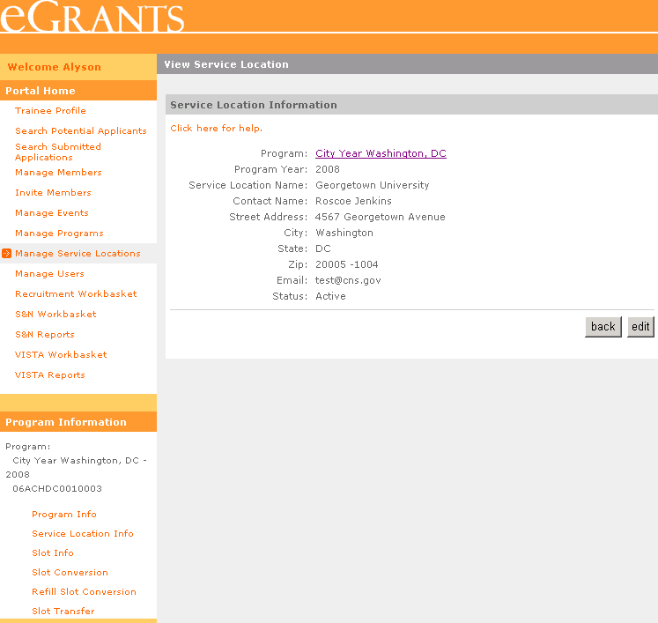
Service Locations
44
View the Operating Site Information page.
Click on edit to make changes to the service location or back to view the listing of service locations page.
eGrants Coaching Unit
Notes:
Once it’s saved, the information will be displayed and the service location will be available for use--if you selected “active” as the status. The name of the program is a link back to the Operating Site Information page.
Correct the details of the service location by clicking on edit.
To retain the integrity of community level and ad hoc reporting, service locations cannot be deleted. If the service location is no longer in use, you can edit the service location and change the status to “inactive”.
The service locations listing page can be viewed by clicking on back.
44

Slide 45
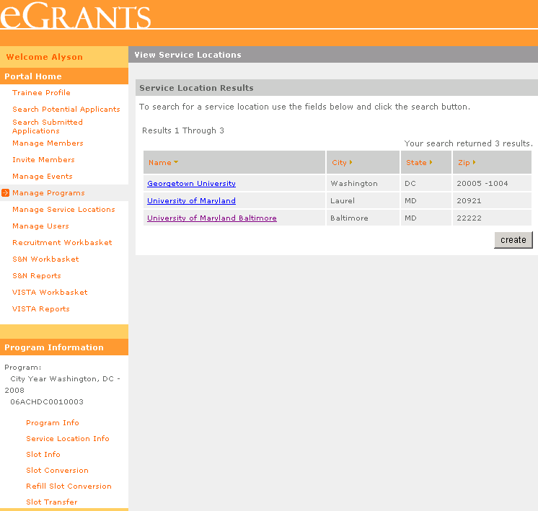
Service Locations
45
The new service location is displayed. Click on the name to view or edit the details.
eGrants Coaching Unit
Notes:
The new service location is displayed. Click on the name to view or edit the details.
45

Slide 46
Service Locations
46
Click on edit to change the information or status of the service location or back to return to the list of service locations.
eGrants Coaching Unit
Notes:
Click on Edit to change the information or status of the service location. Click Back to return to the list of service locations.
Navigating through the process of creating, viewing and editing a service location will eventually return you to the service locations listings page.
46

Slide 47
Member Enrollment

Slide 48
Member Enrollment Workflow
48
Member Enrollment via My AmeriCorps Application Process
Applicant
Registers & submits application to a listed service opportunity.
Program (Grantee Recruiter/Grantee Admin)
Accepts application and extends offer to serve.
Applicant
Accepts invitation and completes Enrollment form (Part 1).
Member
Program (Grantee Admin, Prime, Operating Site)
Starts serving.
Completes & approves Enrollment Form (Part 2) and activates term.
eGrants Coaching Unit
Notes:
Narrative from tutorial:
So, there are two ways to enroll a member. One approach is to enroll a member is through the My AmeriCorps application process.
As you will notice from this workflow overview, an applicant applies to a service opportunity listing, program extends an invitation to serve, applicant accepts the invitation and completes the member’s part (Part 1) of the enrollment process, program completes the program’s section (Part 2) of the enrollment form and enroll the member.
If you are also responsible for member recruitment, we strongly encourage you to attend or view the “AmeriCorps State Programs - Member Recruitment” webinar/tutorial to review the steps on how to create a service opportunity listing, review applications, and select a member.

Slide 49
View Applications
Click S&N Workbasket on the left navigational panel. Then click on the Pending Applications tab located on the top navigational panel
49
Click on the applicant’s name to open the application
Click Print to open up a static text of the application for printing
eGrants Coaching Unit
Notes:
Narrative from tutorial:
Starting at your Recruitment Workbasket, click on the “Pending Applications” tab located on the top navigational panel.
A list of applicants who have submitted an application to your program via My AmeriCorps will be displayed.
If you want to print an application, click “print” link. This will allow you to print the application except for the reference details. If you need to print the reference details, then you will need to open the reference section and print it from there.
Click on the applicant’s name to view their application.

Slide 50
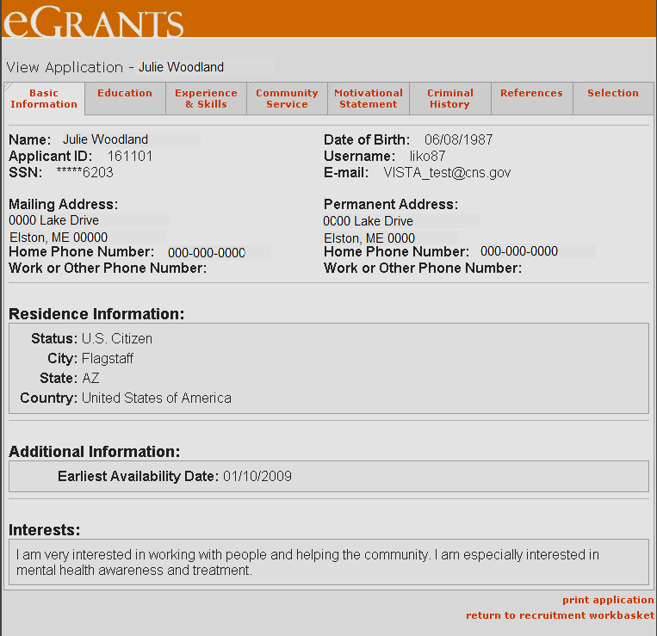
View Applications
50
Click on a tab to view the application details under that tab heading
Click on Print Application to open up a static text of the application for printing. However, reference data will not appear under this view for printing
Click Return to Recruitment Workbasket to return to the list of pending applications
eGrants Coaching Unit
Notes:
Narrative from tutorial:
The application has eight sub-sections and you can view the details of each sub-section by clicking on the section heading tab.
With the exception of the references, you can print the application from this view as well. In order to print the references, each reference must be opened individually.
If you need to return to the pending applications listing page, click on “return to recruitment basket” link.
Now, let’s look at how view references.

Slide 51
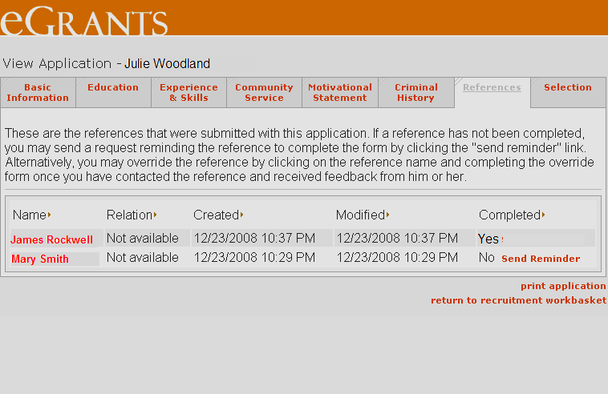
View References
51
Click on the References tab to view the applicant’s references status
If the Completed status of the reference is Yes, click on the reference name to view the details
Click Return to Recruitment Workbasket to return to the list of pending applications
eGrants Coaching Unit
Notes:
Narrative from tutorial:
Under the “Reference” tab, you will see the reference details.
Completed references will be noted with a “Yes,” in the last column. To view the references, click on the person’s name.

Slide 52
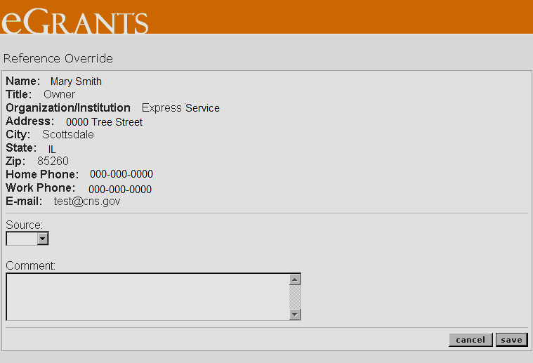
Override References
52
When you click on the reference’s name, the contact information will show up on the Reference Override page
Use the dropdown menu to choose the communication source (fax, mail, phone, other) you used to get the comments
Once you complete the Reference Override, click Save
eGrants Coaching Unit
Notes:
Narrative from tutorial:
When you click on the reference name, it will open up the Reference Override form which lists the individual’s contact information. After you have contacted the reference, you can complete this Reference Override by entering the comments provided by the reference.
Select the type of source (fax, mail, phone, other) you used to get the reference comments.
Enter the reference comments about the applicant.
Click on “save” to save the Reference Override. If you want to discard the entries you made without saving, click “cancel.”

Slide 53
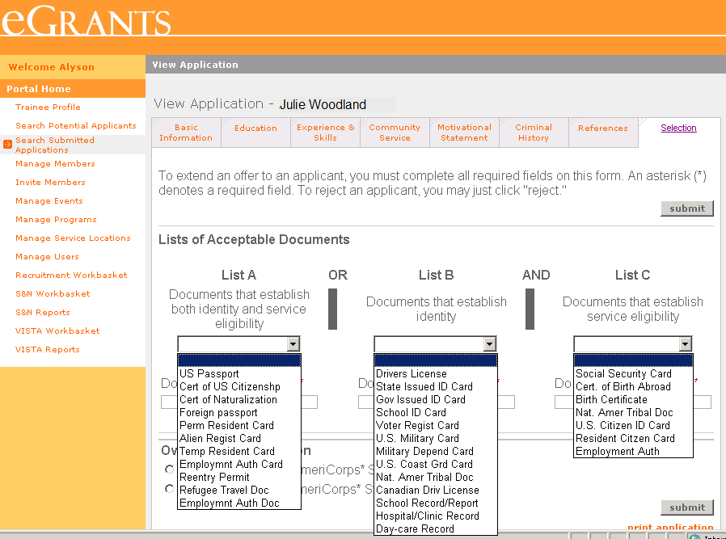
Accept/Reject Applicants
53
When you click on the dropdown menu for a specific list, it will show a list of acceptable documents to choose from.
eGrants Coaching Unit
Notes:
Narrative from tutorial:
Please remember to refer to grant requirements and guidelines, whenever you are performing member management tasks in My AmeriCorps. Although the system may allow you to perform certain tasks, you need to make sure that those tasks are compliant with the grant requirements and guidelines. For example, you need to make sure the documents provided are sufficient to establish member eligibility according to the grant requirements and guidelines.

Slide 54
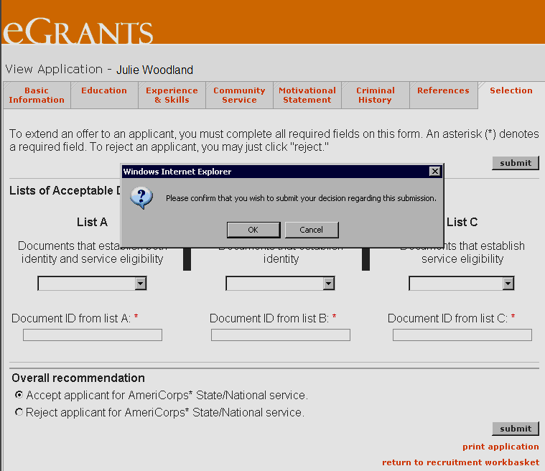
Accept/Reject Applicants
54
When you click Submit you will be asked to confirm your decision. Click OK to confirm or Cancel to cancel your recommendation. Once you have confirmed your decision, you won’t have an opportunity to change it
eGrants Coaching Unit
Notes:
Narrative from tutorial:
If you click on “submit,” a message will appear asking you to confirm your decision.
Once you click “OK” to confirm your decision, you won’t have the opportunity to change it again.
If you accept and application, it doesn’t mean that the applicant has been enrolled into your program. When you accept an application, the applicant will receive an email informing him/her of a change in their application status. When the applicant logs onto their account, they will see the status of their application with each organization that they have submitted an application to.
Then the applicant will accept your invitation and complete the member’s section (Part 1) of the enrollment form. In order to enroll the member, you will then open the member’s enrollment form, which will be listed under “Pending Enrollments,” and complete it and save it.

Slide 55
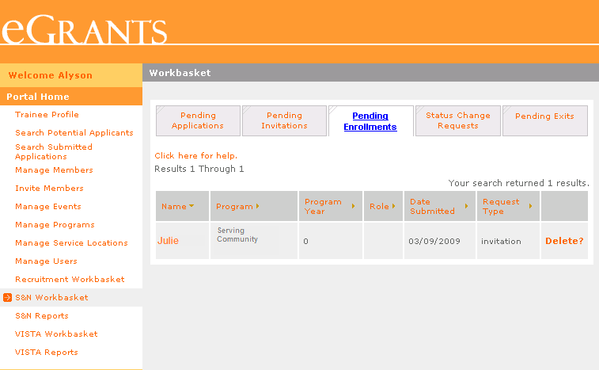
Enroll Members (Enrolling members who were selected through My AmeriCorps application process)
55
Click S&N Workbaskets on the left navigational panel. Then click the Pending Enrollments tab located on the top navigational panel
Click the member’s name to open the enrollment form
Click Delete if you want to delete the enrollment form
eGrants Coaching Unit
Notes:
Narrative from tutorial:
Members who were selected through My AmeriCorps application process will be listed under “pending Enrollments” tab.
If you are not going to enroll the member, click on “Delete.”
Click on the member’s name to open the enrollment form to complete the member’s portion of the enrollment form on behalf of the member and/or enter the placement information and/or enroll the member (activate the member’s term).

Slide 56
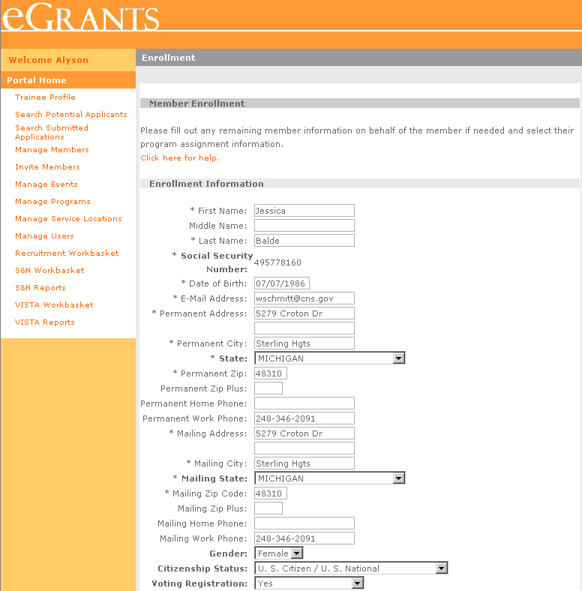
Enroll Members (Enrolling members who were selected through My AmeriCorps application process)
56
If the member has completed his/her portion of the enrollment form, the data will be displayed in read mode. In this case, you may scroll down to the bottom and enter information about the member’s term
Required fields are marked with an asterisk (*)
If the member has not completed his/her portion, you can complete it using the information given in enrollment form that was signed by the member
eGrants Coaching Unit
Notes:
Narrative from tutorial:
If the member has completed the member’s portion of the enrollment form, that information will appear in the read mode. In this case, you may scroll down to the bottom and enter information about the member’s term.
If the member has not completed member’s portion, you can complete it using the information given in member’s signed paper enrollment form.

Slide 57
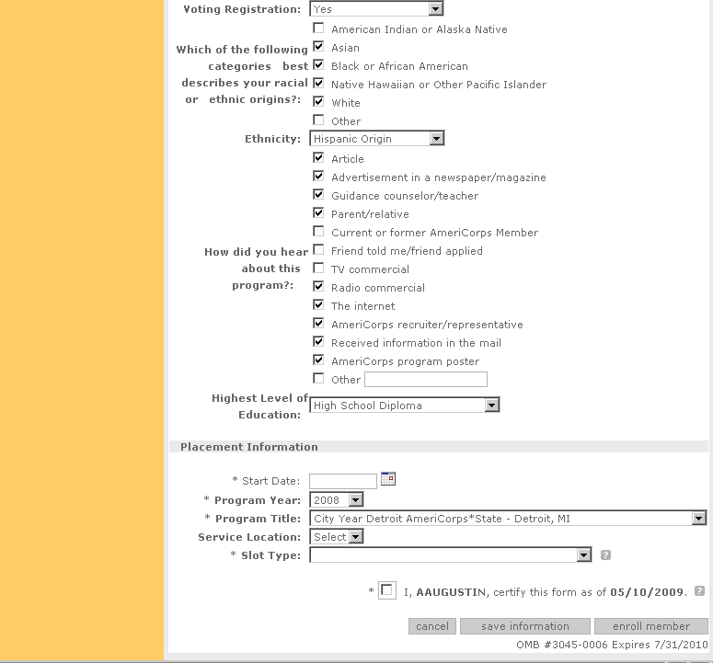
Enroll Members (Enrolling members who were selected through My AmeriCorps application process)
57
Enter the member’s start date and select Program Year, Program Title, Service Location and Slot Type. Select the checkbox to certify your portion of the enrollment
Click Save Information to save the enrollment data without activating
Click Enroll Member to activate the member’s enrollment
Click Cancel to discard any changes made
eGrants Coaching Unit
Notes:
Narrative from tutorial:
Enter the member’s start date and select program year, program title, service location and slot type.
Select the checkbox to certify your portion of the enrollment form.
Click on “save information” to save the enrollment form without activating the enrollment.
To activate the member’s enrollment click on “enroll member”.
If you want to discard the entries entered, click on “cancel.”

Slide 58
Member Enrollment Workflow
58
Member Enrollment via My AmeriCorps Invitation Process
Program (Grantee Admin, Prime, Operating Site) enters or uploads invitation.
Applicant
Registers & complete the Enrollment Form (Part 1).
Program (Grantee Recruiter/Grantee Admin)
Program/Operating Site
Completes Enrollment Form (Part 1) on behalf of the member
Completes & approves Enrollment Form (Part 2) and activates term.
Completes and approves Enrollment Form (part 2) and activates term.
Member
Starts serving.
eGrants Coaching Unit
Notes:
Narrative from tutorial:
The second approach to enroll a member is through My AmeriCorps Invitation process. In this situation, the program will enter or upload a service invitation for a member/s.
Following the service invitation the member registers and completes the member’s portion (Part 1) of the enrollment form or the program/service location will complete the member’s portion of the enrollment form on behalf of the member and enroll the member.
Member enrollment via My AmeriCorps Invitation Process, allows programs to enroll members to My AmeriCorps whom they have recruited through a different system as well as enroll members in My AmeriCorps who may not have computer and/or internet access.
So, let’s look at the specific steps on how to enroll a member through the invitation process. First, we are going to look at how to create an invitation.

Slide 59
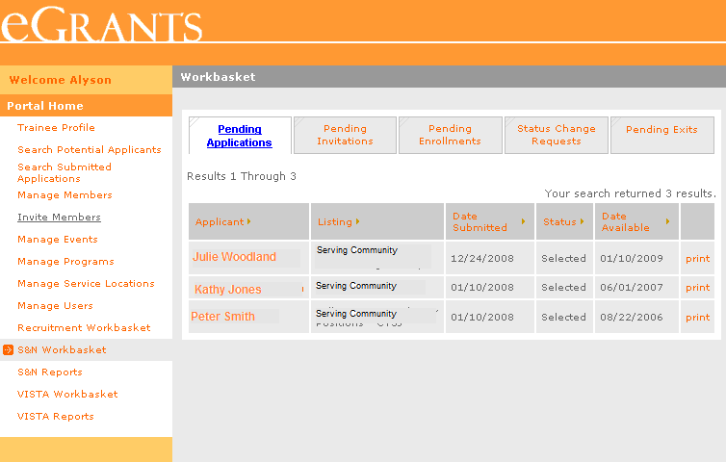
Invite Members
59
Click on Invite Members on the left navigational panel
eGrants Coaching Unit
Notes:
Narrative from tutorial:
Once again, the use of this function will be to get people you recruited outside of My AmeriCorps into the My AmeriCorps system and start the enrollment process or to complete the member’s portion (Part 1) of the enrollment form on behalf of applicants who may not have access to the Internet.
Click on “Invite Members’ on the left navigational panel.

Slide 60
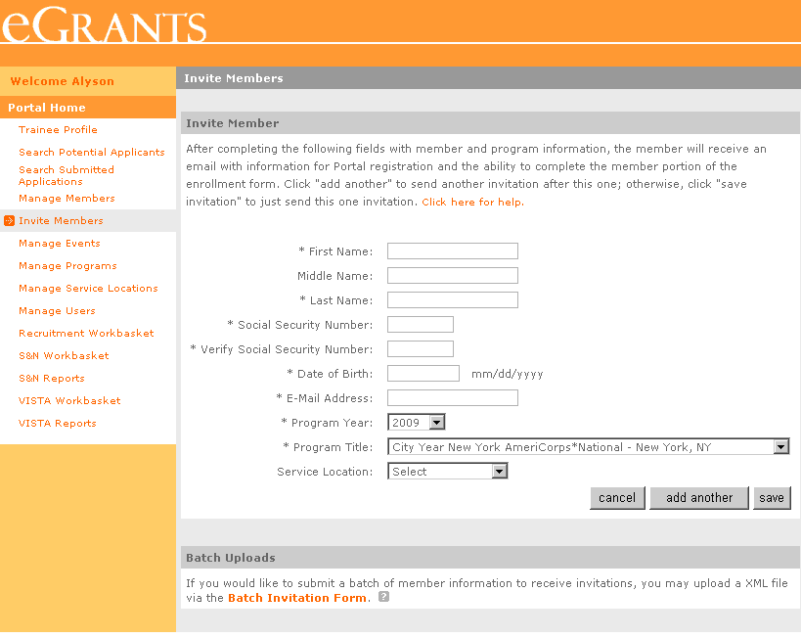
Invite Members
60
Enter member’s data and select the program, grant year and member’s service location
Click on Add Another to send the current invitation and enter another invitation
Click Save to send one invitation and return to your home page
Click Cancel to discard any entries you made
eGrants Coaching Unit
Notes:
Narrative from tutorial:
Enter the member’s data and select the Program Title, Program Year and Service Location. Please note that until you select the Program Title and Program Year, the “add another” and “save” functions/buttons will not show up on the page.
Click on “add another” to send the current invitation and enter another invitation.
Click on “save” to send only one invitation and return to your home page.
If you click on “cancel” it will discard any entries you have entered.
If you want to invite a group of members for a specific program/service location, click on “Batch Invitation Form” link listed at the bottom of this Invite Member page.

Slide 61
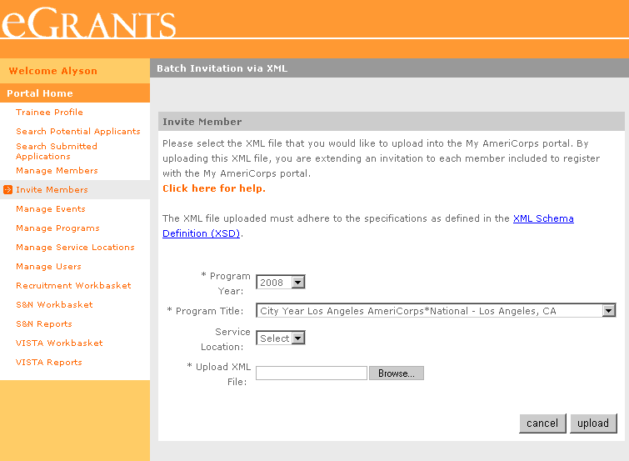
Invite Members – Batch Invitations
61
Make sure the XML file you want to upload meets the specifications defined in the XML Schema Definitions (XSD)
Choose the Program Year, Program Title and Service Location. Click Browse to select the XML file you want to upload
Click Upload
eGrants Coaching Unit
Notes:
Narrative from tutorial:
Select the Program Title, Program Year and Service Location. Note that until you select the Program Title and Program Year the Upload HML file and “Browse” function will not show up on the page.
Click on “Browse” button to select the XML file you want to upload from your computer. Make sure the XML you have created meet the specifications as defined in the XML Schema Definition (XML).
Click on “upload.” Now the entries you uploaded will appear in your Pending Invitations Workbasket until you or the member completes the member's portion (Part 1) of the enrollment form.
Click on “Cancel” to discard any selections you may have made.
Now, let’s look at how to enroll a member who has been invited through the invitation process.

Slide 62
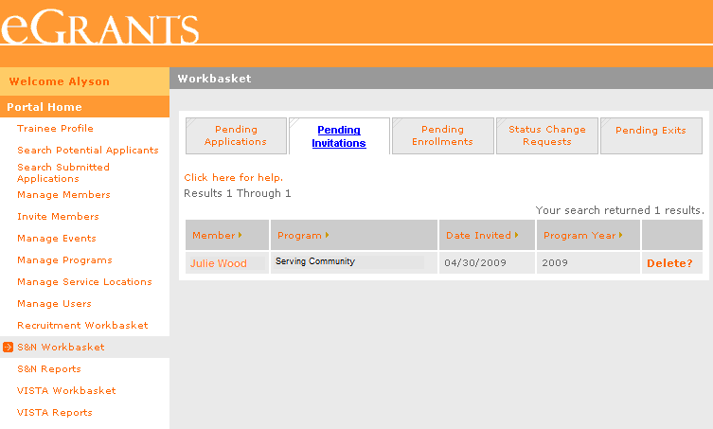
Enroll Members (Enrolling members who were Invited through the invitation process)
62
Click S&N Workbaskets on the left navigational panel. Then click the Pending Invitations tab located on the top navigational panel
Click the member’s name to open the enrollment form
Click Delete if you are not going to enroll the member
Until the invitee or you complete the member’s portion of the enrollment form, the members who were invited through the invitation process will be listed under “Pending Invitations”
eGrants Coaching Unit
Notes:
Narrative from tutorial:
Click on “S&N Workbaskets” on the left navigational panel and click on the “Pending Invitations” tab.
Until the invitee or you complete the member’s portion of the enrollment form, the members who were invited through the invitation process will be listed under “Pending Invitations”
If you are going to complete the member’s portion (Part 1) of the enrollment form on behalf of the member, click on the member’s name to open the enrollment form.
If you are not going to enroll the member, click on “Delete.”

Slide 63
Enroll Members (Enrolling members who were Invited through the invitation process)
63
Required fields are marked with an asterisk (*)
If you are going to complete the member’s portion of the enrollment form, you should complete it using the information given in enrollment form that was signed by the member
eGrants Coaching Unit
e
Notes:
Narrative from tutorial:
If you are completing the member’s portion (Part 1) of the enrollment form, you should complete it using the information given in member’s signed paper enrollment form.

Slide 64
Enroll Members (Enrolling members who were Invited through the invitation process)
Enter the member’s start date and select Program Year, Program Title, Service Location and Slot Type. Select the checkbox to certify your portion of the enrollment
64
Click Save Information to save the enrollment data without activating
Click Enroll Member to activate the member’s enrollment
Click Cancel to discard any changes made
eGrants Coaching Unit
Notes:
Narrative from tutorial:
Enter the member’s start date and select program year, program title, service location and slot type.
Select the checkbox to certify your portion of the enrollment form.
Click on “save information” to save the enrollment form without activating the enrollment. This will move the enrollment form from “Pending Invitations” to “Pending Enrollments.”
To activate the member’s enrollment click on “enroll member”.
If you want to discard the entries entered, click on “cancel.”

Slide 65
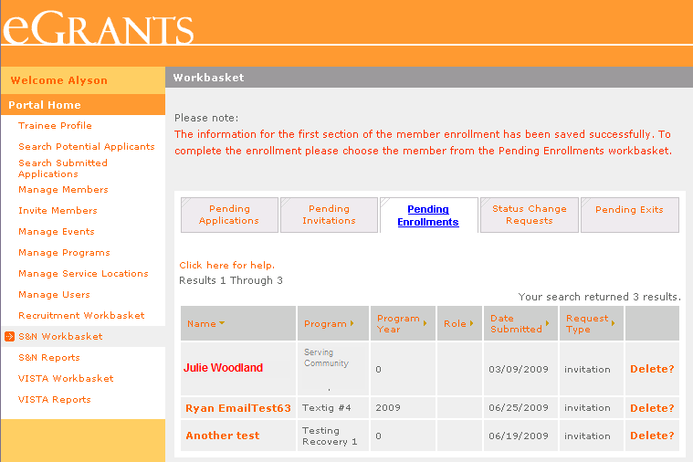
Enroll Members (Enrolling members who were Invited through the invitation process)
65
The member’s enrollment form will appear under the “Pending Enrollments,” if you had clicked on “save information” on the member enrollment form from the “Pending Invitations” section or if the invitee had completed the member’s portion of the enrollment form
eGrants Coaching Unit
Notes:
Narrative from tutorial:
As you will notice here, the member’s enrollment form will appear under the “Pending Enrollments,” if you had clicked on “save information” on the member enrollment form from the “Pending Invitations” section or if the invitee had completed the member’s portion of the enrollment form.
Click on the member’s name to open the enrollment form to enter the placement information and/or enroll the member (activate the member’s term).

Slide 66
Member
Exit

Slide 67
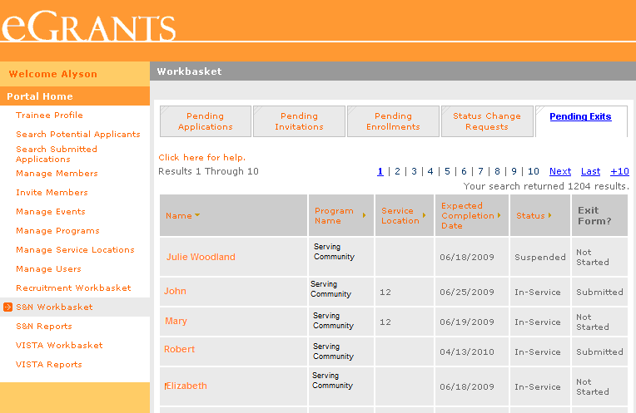
Member Exit
67
Members who are approaching the end of their service (30 days prior to their expected completion date) will be listed in your Pending Exits workbasket. These members will have access to a link on their home page to complete their portion of the exit form which includes an option for them to complete their Member Satisfaction Survey
Click on Pending Exits
Not Started means the member’s portion of the Exit has not yet been completed
Submitted means the member has completed the section and is awaiting approval
If you want to complete the member’s portion of the exit, click on his/her name
eGrants Coaching Unit
Notes:
Narrative from tutorial:
Members who are approaching the end of their service (30 days prior to their expected completion date) will be listed in your pending exits basket.
Members with an email address provided in MY AmeriCorps will receive an email notification of approaching end of service. These members will have access to a link on their home page to complete their portion of the exit form which includes an option for them to complete their Member Satisfaction Survey. You may want to encourage the members to complete their portion of the exit form to reduce your data entry burden and make the exit process go smoothly for the member.
To exit a member as scheduled, click on “Pending Exits” tab located on the top navigational panel.
The pending Exit forms will be in either “Not Started” or “Submitted” status.
“Not Started” means that the form has not yet been completed by the member.
“Submitted” means that the member has completed member’s portion of the Exit form and is awaiting approval.
Let’s say the member has not completed the member’s portion electronically (Not Started) and you want to complete the member’s portion using the paper exit form that was signed by the member.
Click on the member’s name. This will open up the exit form.

Slide 68
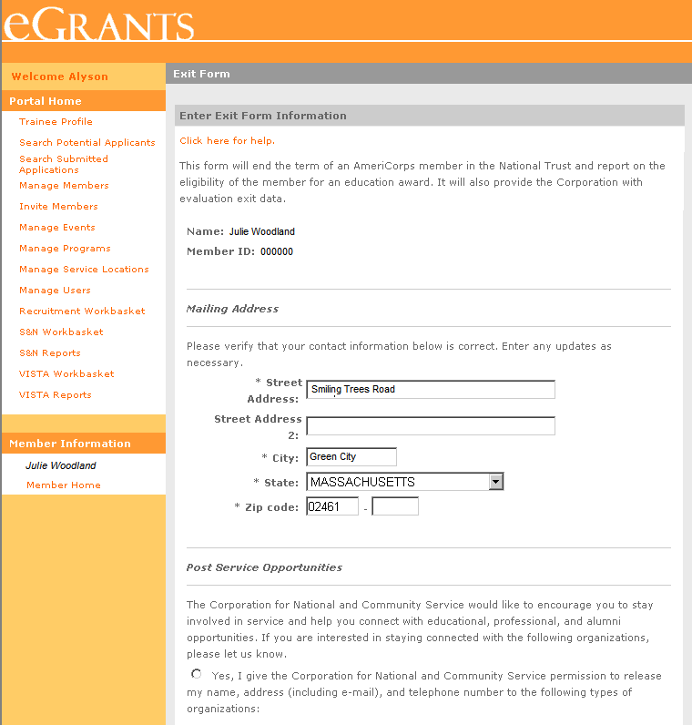
Member Exit
68
If you are completing the member’s portion of the exit form, you should do so by using the exit form that was signed by the member
Update the member’s mailing address as necessary
Select whether or not the member wishes to allow the Corporation to release their contact information to service organizations
eGrants Coaching Unit
Notes:
Narrative from tutorial:
Be sure to update the member’s mailing address as necessary.
Under “Post Service Opportunities”, indicate whether or not the member wishes the Corporation to release their contact information to service organizations.

Slide 69
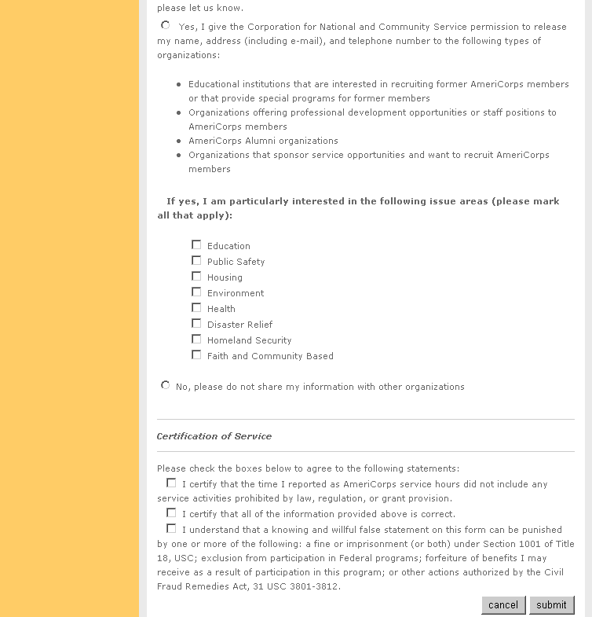
Member Exit
69
Complete the Certification of Service on behalf of the member
Click on Submit
eGrants Coaching Unit
Notes:
Narrative from tutorial:
Then complete the Certification of Service on behalf of the member.
Click on “submit”. This will open up the confirmation page. The system will log who completed the information and this information will be available in the audit reports.

Slide 70
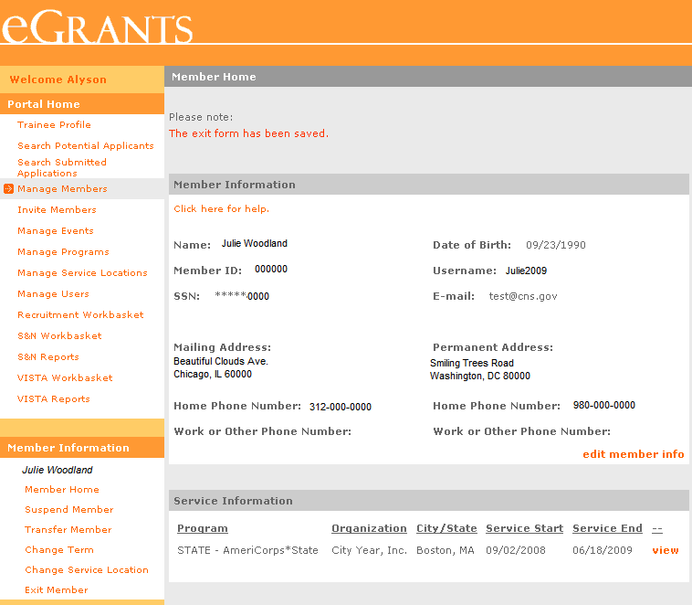
Member Exit
70
A confirmation message will appear indicating that the member’s portion of the Exit Form has been saved
Click on Exit Member to open the Exit Form and exit the member
eGrants Coaching Unit
Notes:
Narrative from tutorial:
When you click “submit”, you will see the message, “the exit form has been saved” at the top of the member info page.
Now we are going to look at how to approve an exit form and exit a member.
Click on “Exit Member” link on the left navigational panel. It will open up the Member Exit form.

Slide 71
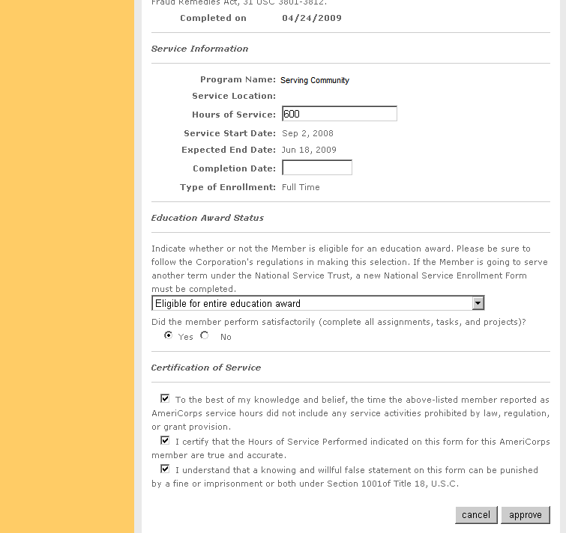
Member Exit
71
Enter the total number of hours the member served
Enter the date the member completed their service
Select the award status for the member’s term
eGrants Coaching Unit
Notes:
Narrative from tutorial:
You will enter information about the member’s end of service in the “Service Information” and “Education Award Status” sections. This will include the total number of hours the member served and the date they completed their service. The completion date cannot be a future date. This is because when you complete this section of the Exit Form and click “approve,” it actually exits the member.
Select the award status for the member’s term. The system will perform a validation check on the selected education award status based on the number of hours of service entered.

Slide 72
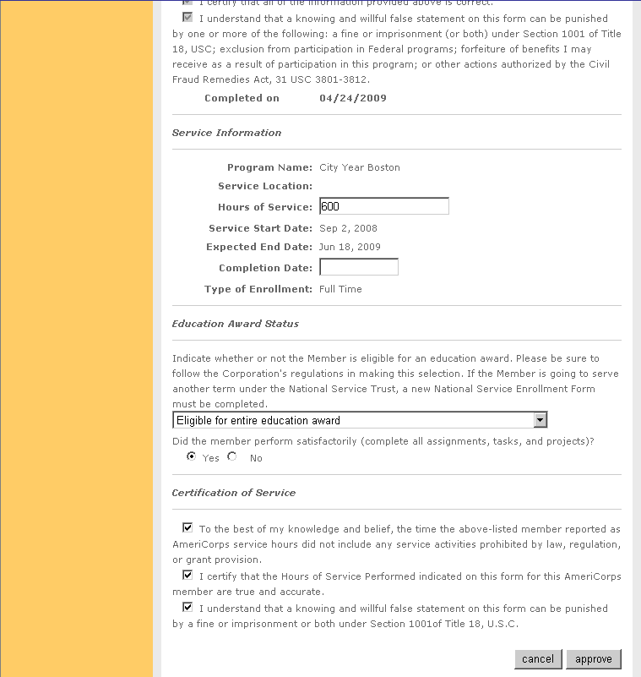
Member Exit
72
Indicate whether or not the member performed satisfactorily
Check boxes under Certification of Service to certify the information you have entered on the exit form is correct
If you want to discard any changes you have made, click Cancel
Click on Approve to exit the member
eGrants Coaching Unit
Notes:
Narrative from tutorial:
Indicate whether the member performed satisfactorily. Only select no if this member should never be considered to serve with AmeriCorps again in the future.
You will need to certify the information you are entering by selecting the check boxes under “Certification of Service”.
If you want to discard any changes you have made, you may click the “cancel” button and back out of this page.
To exit the member, click “approve”. This will deactivate the member’s tem in the Trust. Contact your Trust Officer to make any changes to an exit form after it has been approved.

Slide 73
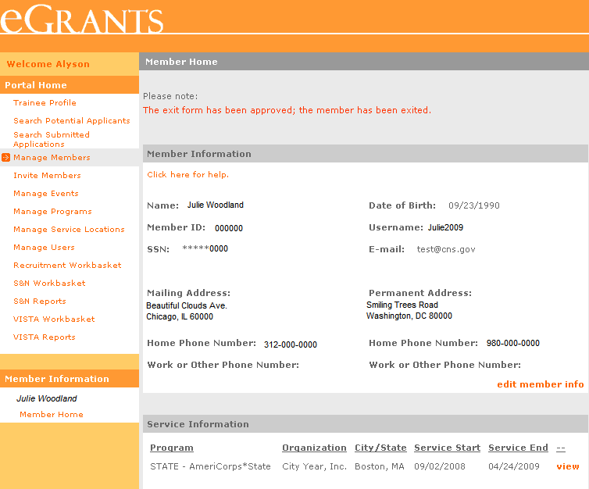
Member Exit
73
A confirmation message will appear indicating that the member has been exited
The Service End Date will be updated accordingly
eGrants Coaching Unit
Notes:
Narrative from tutorial:
When you click “submit”, you will see the message, “the exit form has been approved; the member has been exited” at the top of the member info page.
You will also notice that Service End Date has been updated accordingly.
Now, we are going review how to exit a member early which could be done for a variety of reasons.

Slide 74
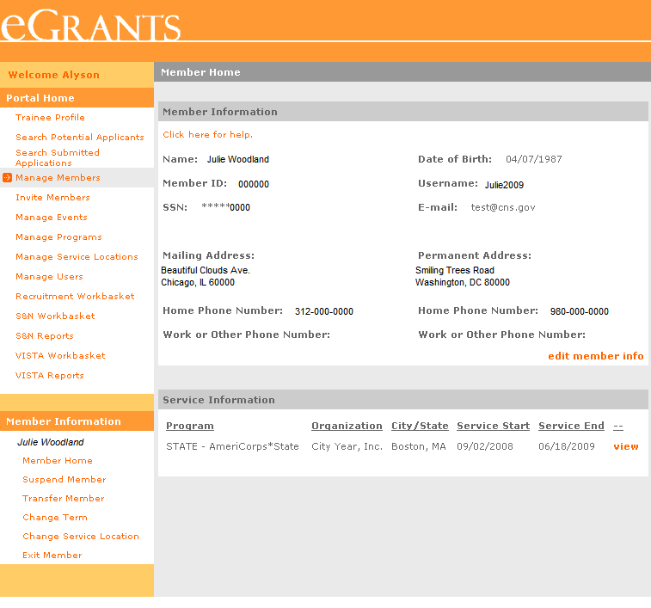
Member Exit - Early
74
When exiting a member early, the member’s exit form will not be listed in your Pending Exits workbasket, nor will the member have access to it from their home page. Therefore, you have to manually place the exit form in the Pending Exits Workbasket for members who need to be exited early. This will also allow the member to complete their portion of the exit form
Click View next to the appropriate service term to open the term’s service page info
eGrants Coaching Unit
Notes:
Narrative from tutorial:
A member who needs to exit early will not have an exit form listed in your Pending Exits Workbasket nor will have the member have access to it from their home page.
Therefore, you will need to manually place the exit form in the Pending Exits Workbasket. This will also allow the member to complete their portion of the exit form.
Let’s see how you would place the exit form manually in the Pending Exits Workbasket.
Open the member’s page and click “view” next to the current service term. This will open up the current service term information page.

Slide 75
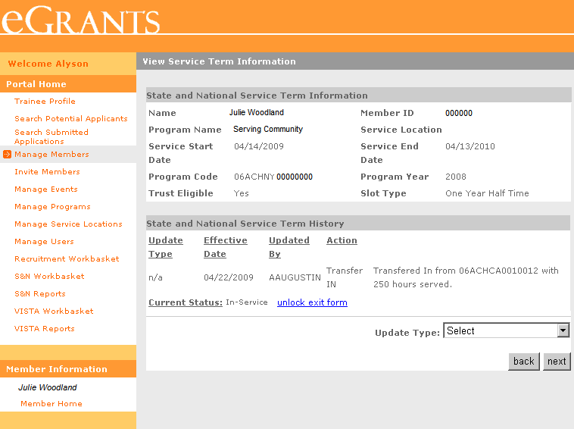
Member Exit - Early
75
Once you unlock the exit form, you can wait for the member to complete member's portion of the Exit form or you can complete it on behalf of the member if the member has already completed and signed the paper exit form. Once the member’s portion is completed, exit the member.
Click Unlock Exit Form. The member will appear in your Pending Exit Workbasket
eGrants Coaching Unit
Notes:
Narrative from tutorial:
On this page you will see an “unlock exit form” link.
Click on “unlock exit form,” and then the member will appear in your Pending Exits Workbasket.
As we discussed earlier, you can wait for the member to complete their portion of the Exit form or you can complete it on behalf of them if they have already completed and signed the paper exit form.
Now, you will follow the same steps we looked at in exiting a member on schedule to exit the member.
Finally, we would like to kindly remind you that the system does not send automated email notifications to prime or operating sites/program staff in regard to any pending items associated with workbaskets. Therefore, we strongly recommend that the program staff frequently check the workbaskets.

Slide 76
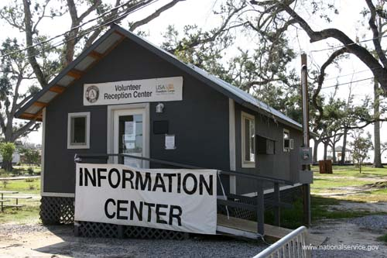
What’s next?
76
The Resource Center
www.nationalserviceresources.org/ac-training-support
Includes other tutorials
The eGrants Help Desk
1-800-942-2677
Technical Assistance
User name/Password reset assistance
eGrants Coaching Unit
3/26/13
Notes:
Narrative from the tutorial:
For technical assistance such as unlocking accounts and resetting username and password, please contact the Help Desk at 1-800-942-2677.
76

